Slide 1
Mississippi Health Ambassadors
Thomas Dobbs, MD, MPH
3/20/2024

Slide 2
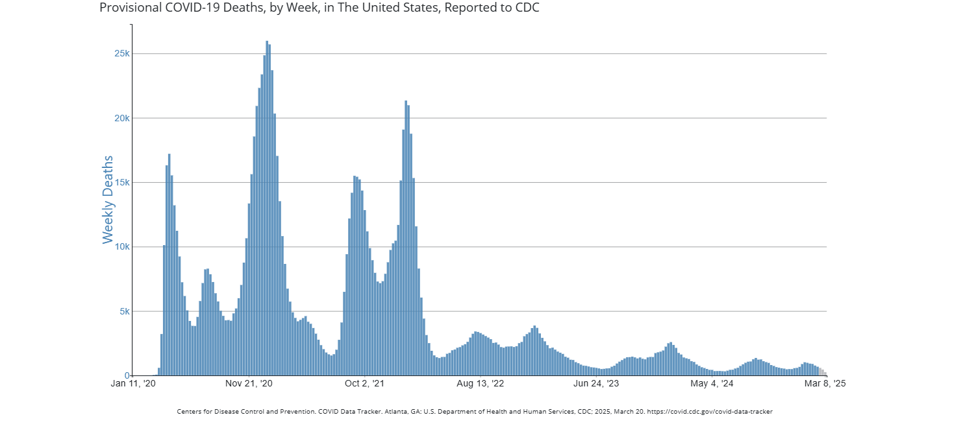

Slide 3
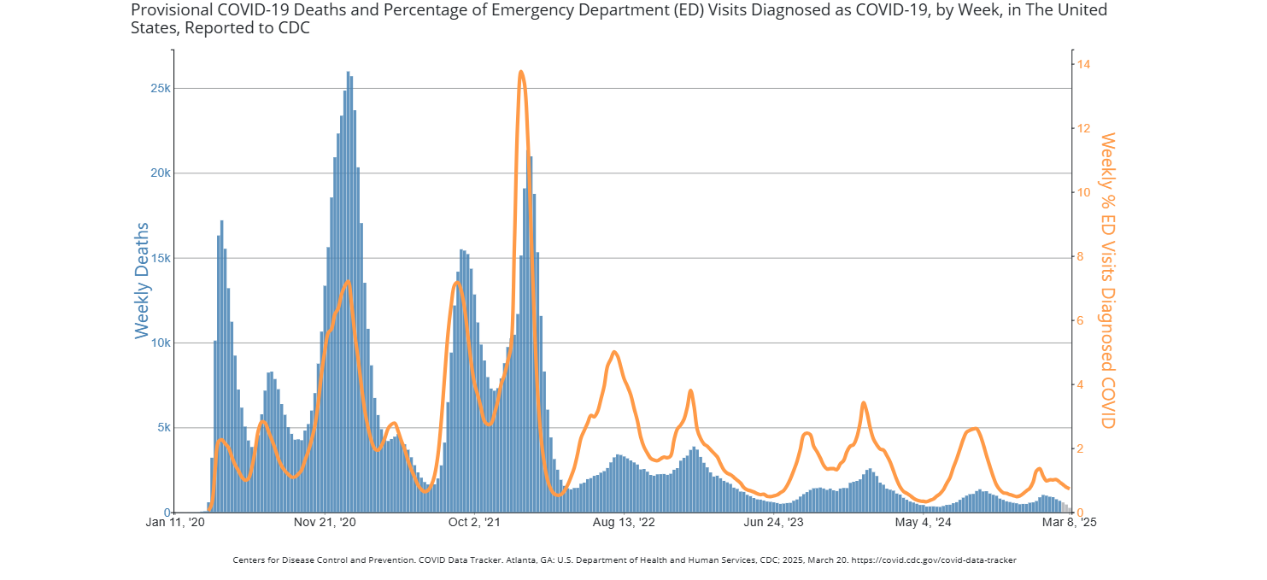

Slide 4
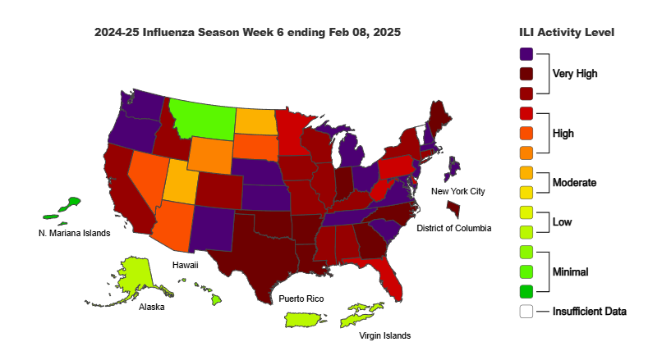

Slide 5
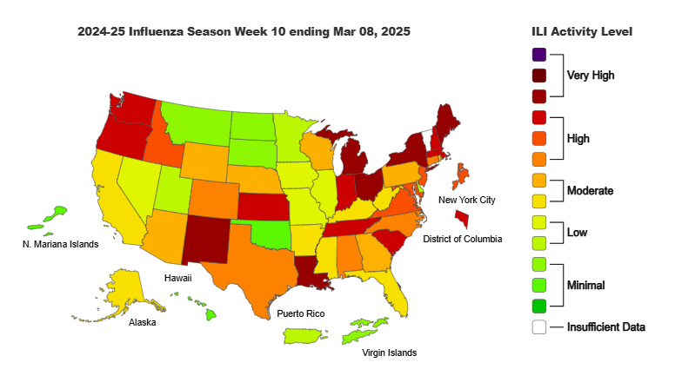

Slide 7
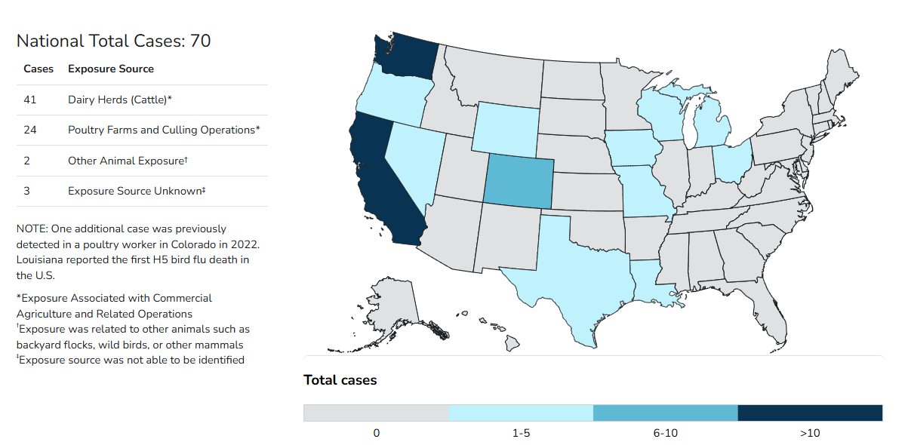

Slide 8
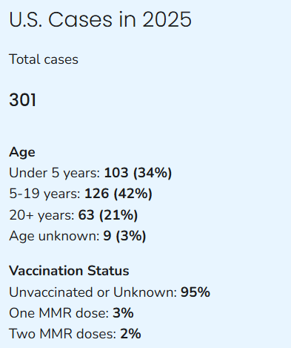
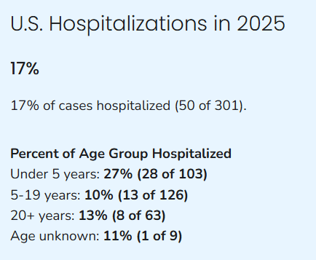
Measles

Slide 9
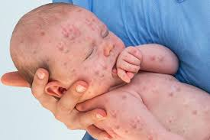
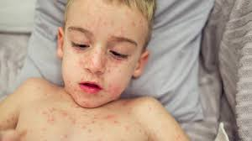
Measles
Measles is a highly contagious, serious airborne disease caused by a virus that can lead to severe complications and death.
Measles vaccination averted more than 60 million deaths between 2000 and 2023.
107 500 measles deaths globally 2023, mostly among unvaccinated or under vaccinated children under the age of 5 years.

Slide 10
How Contagious is Measles?

Slide 11
Population Immunity
Sustained
transmission
Transmitting
case
Susceptible
Transmitting
case
Susceptible
Transmission
terminated
Transmitting
Case (A)
Immune (B)
Susceptible (C)
(Indirectly
Protected)
Notes:
The mass vaccination campaigns allowed health authorities to achieve “herd immunity”.
The theory behind the development of “herd immunity” is: in diseases that can be passed from person to person, it is more difficult to pass that disease easily when there are those who are immune to it. The more immune individuals there are, the less likely it is that a susceptible person will come into contact with someone who has the disease
For example, if “Person A” had smallpox and exposed “Person B” who was immune because of vaccination, “Person B” would not get ill and could not pass on the disease to “Person C.” when he comes into contact with him. So even if “Person C” is not vaccinated, he gets indirectly protection from the disease.

Slide 12
0 % Immunity
90 % Immunity
95 % Immunity
1
1
1
18
2
1
4
0
324
8
5832
Measles Transmission and Population Immunity

Slide 13
Herd Immunity Thresholds for Selected Vaccine-Preventable Diseases
 |  |  | Immunization Levels
Disease | R_{o} | Herd Immunity | 1999 19-35 Months | 1997-1998 Pre-School
Diphtheria | 6-7 | 85%* | 83%* | 9%
Measles | 12-18 | 83-94% | 92% | 96%
Mumps | 4-7 | 75-86% | 92% | 97%
Pertussis | 12-17 | 92-94% | 83%* | 97%
Polio | 5-7 | 80-86% | 90% | 97%
Rubella | 6-7 | 83-85% | 92% | 97%
Smallpox | 5-7 | 80-85% | __ | __
*4 doses
† Modified from Epid Rev 1993;15: 265-302, Am J Prev Med 2001; 20 (4S): 88-153, MMWR 2000; 49 (SS-9); 27-38
Notes:
This slide shows the estimated herd-immunity thresholds needed to stop transmission for several communicable diseases.
The R_{o} , or the number of usual secondary transmissions from a single case of the disease, for several vaccine preventable diseases
Notice that smallpox is actually less “transmissible” than measles and pertussis
What this slide doesn’t show is the fact that even if desired herd immunity levels can be reached, outbreaks of the disease can and still do occur, though not to the extent they occurred before larger-scale immunity was achieved
Because outbreaks of disease can still occur even when a high level of herd immunity is achieved, other measures were ultimately also needed to accomplish the eradication of smallpox

