Slide 1
COVID-19 Update
Mississippi Health Ambassador Initiative
Paul Byers, MD 1/16/2025

Slide 2
Respiratory Virus Activity Levels
Amount of acute respiratory viruses currently circulating and causing illness remains high (flu, RSV, COVID-19)
Test positivity elevated for flu and COVID-19 and increasing for RSV
Wastewater surveillance indicates high levels of flu and COVID-19

Slide 3
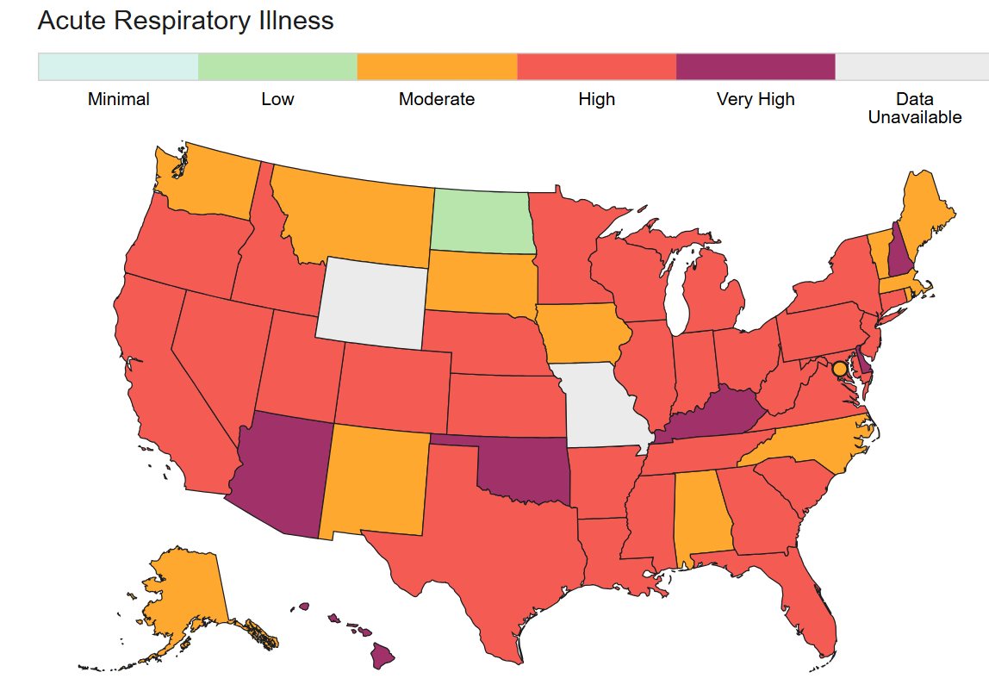

Slide 4
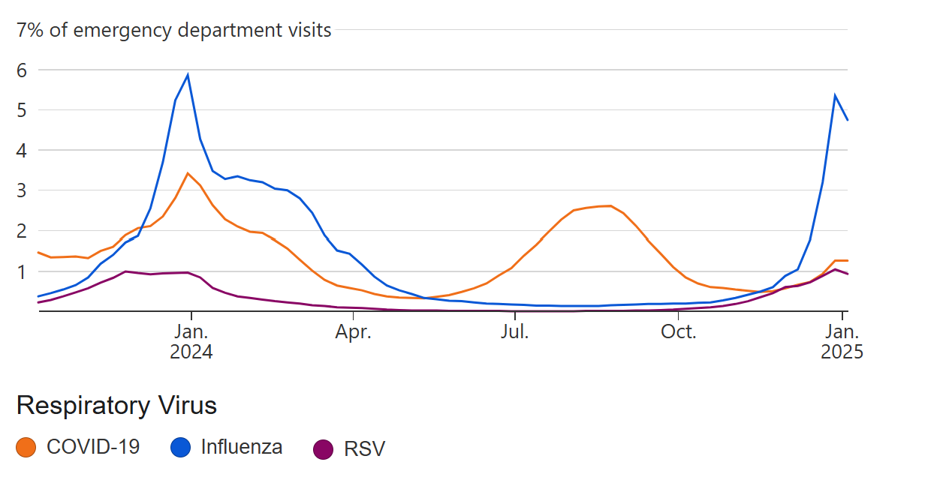
US

Slide 5
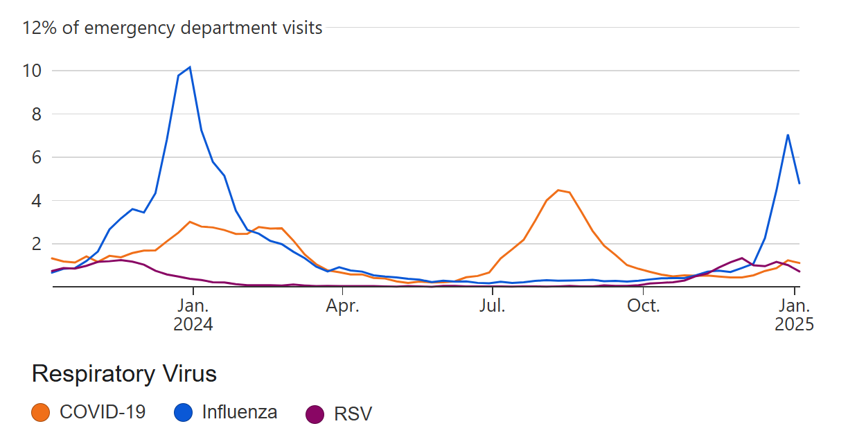
Mississippi

Slide 6
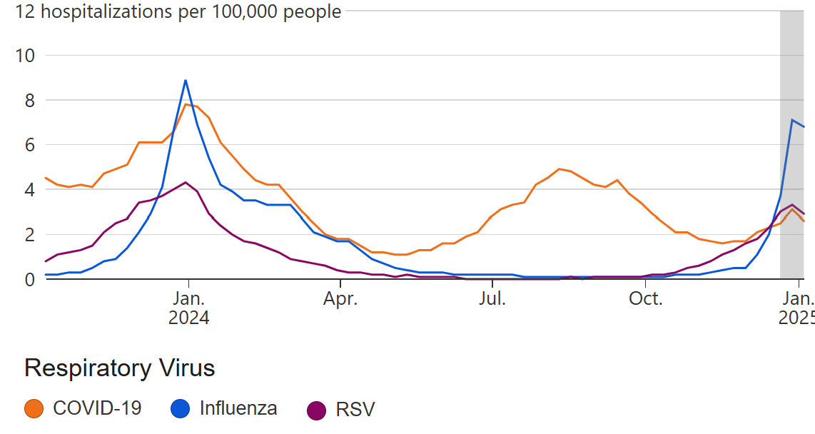
US Hospitalizations due to Respiratory Viruses

Slide 7
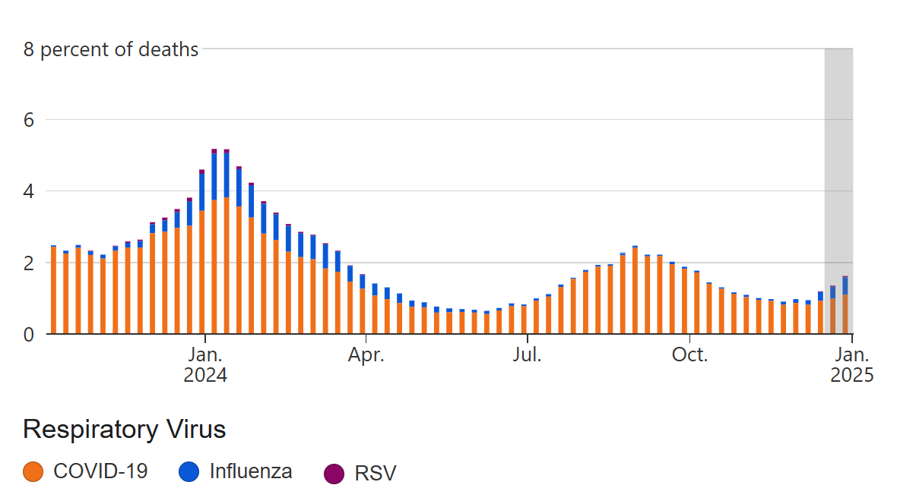
US Deaths Due to Respiratory Viral Illnesses

Slide 8
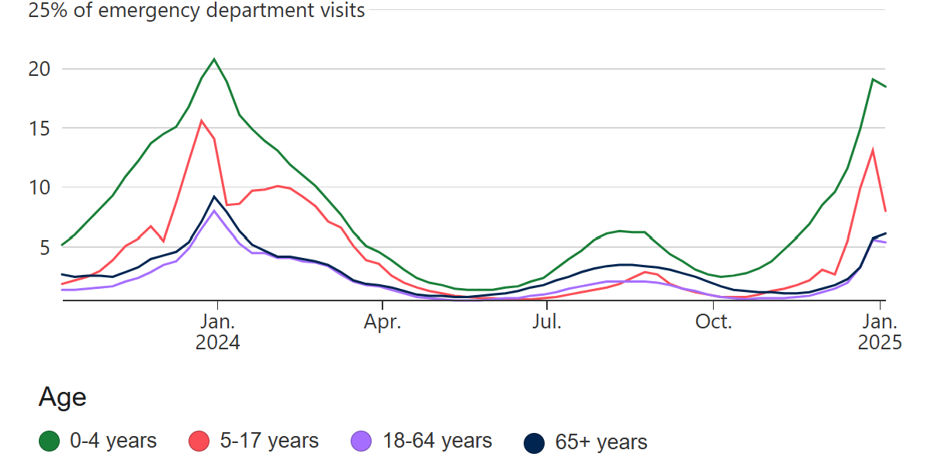
ED Visits by Age Group

Slide 9
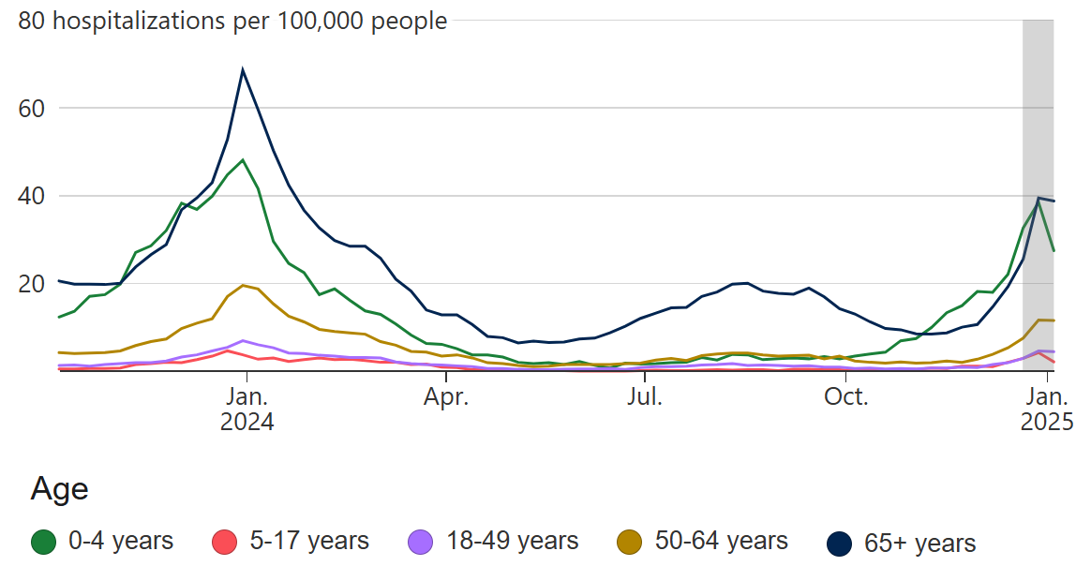
Hospitalizations by Age Group

Slide 10
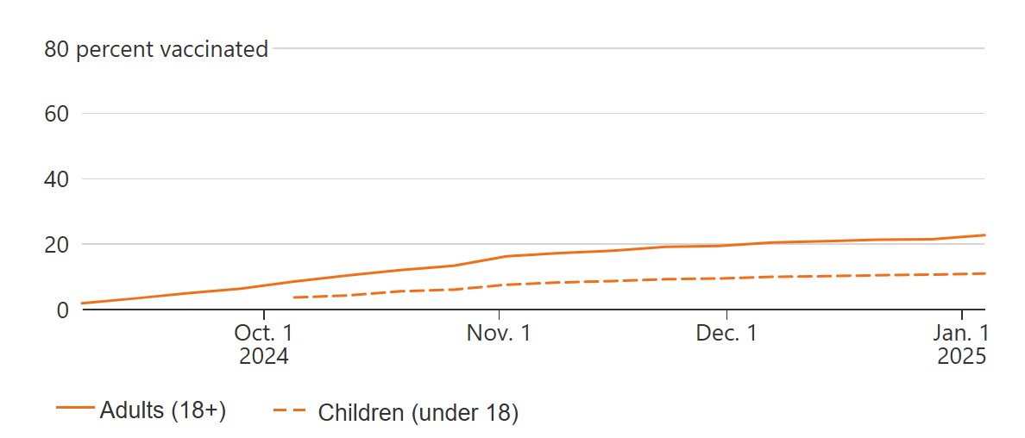
COVID-19 Vaccination, Updated 2024-2025 Booster

Slide 11
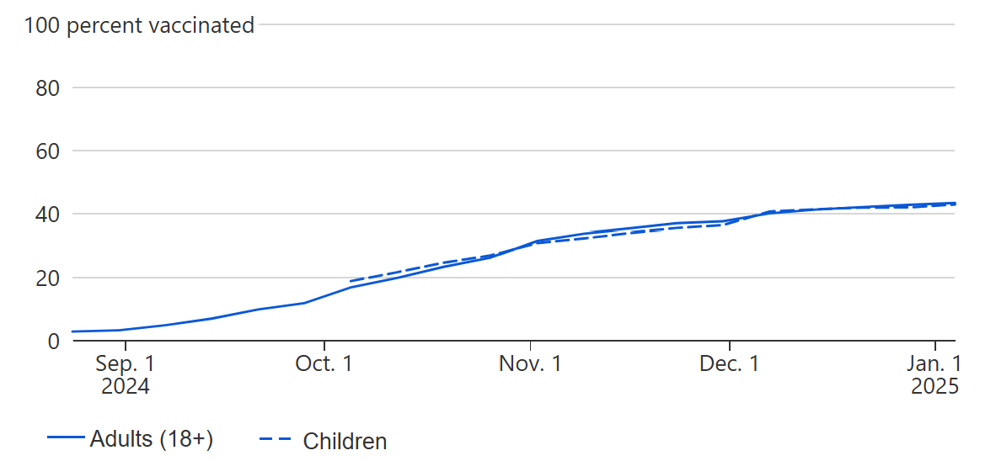
Flu Vaccination, 2024-2025 Seasonal Vaccine

Slide 12
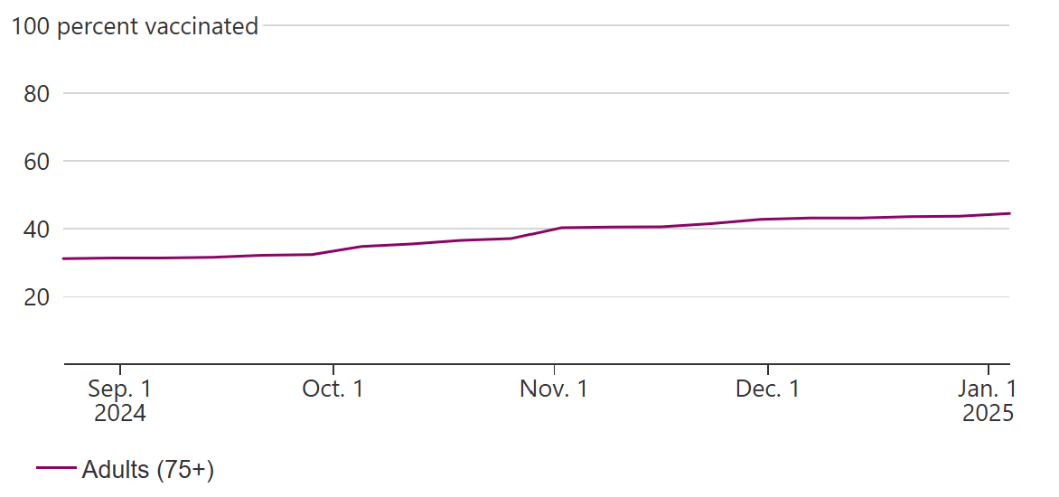
RSV Vaccination, Adults >75 years of age

Slide 13
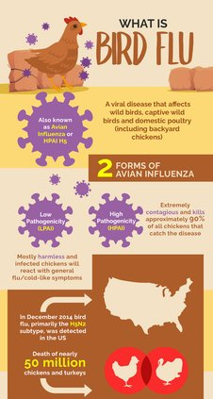
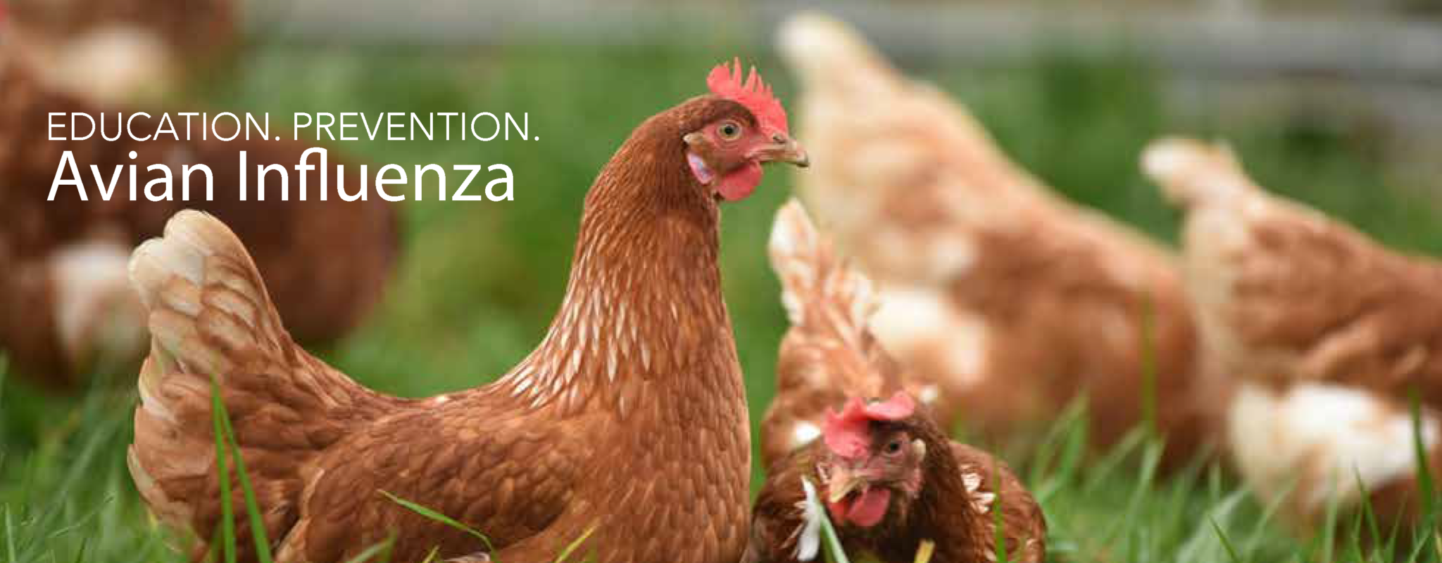
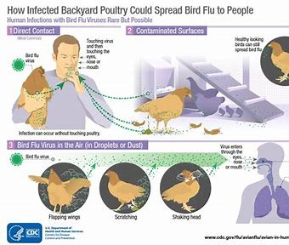
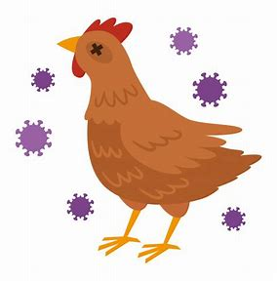

Slide 14
H5N1 Influenza A Death
Severe Avian Influenza or “Bird Flu”
First person in the US who died from H5N1 infection
66 confirmed cases of H5N1 in the US since the beginning of 2024
The first infected child reported in November 2024
Outside of the US, 950 cases of H5N1 infection reported, with about 50% mortality
Risk to general population remains low, no person-to-person transmission as been identified
Most H5N1 infections are a result of exposures to infected animals

Slide 15
Highly Pathogenic Avian Influenza (HPAI)
Sporadic human infections with highly pathogenic avian influenza A(H5N1) virus have been reported in 23 countries over more than 20 years.
HPAI A(H5N1) viruses have spread widely among wild birds worldwide since 2020–2021, resulting in outbreaks in poultry and other animal
Most human infections with H5N1 virus have occurred after unprotected exposures to sick or dead infected poultry. Wide clinical spectrum with case fatality of more than 50%
Recently, HPAI A(H5N1) viruses were identified in dairy cows, and in unpasteurized milk samples, in multiple U.S. states
In March 2024, there was a reported case of HPAI A(H5N1) virus infection in a dairy farm worker in Texas.

Slide 16
About Avian Influenza
Multiple strains of Avian Influenza, including many H5 and H7 flu viruses
Defined a low pathogenicity avian influenza (LPAI) and highly pathogenic avian influenza (HPAI) based on the severity of illness in birds
Identified in more than 200 animals in the US, including poultry, and most recently, dairy cows
Can spread rapidly in domestics flocks leading to significant economic impacts
Has led to several infections in farm workers through direct exposure to infected animals

Slide 18
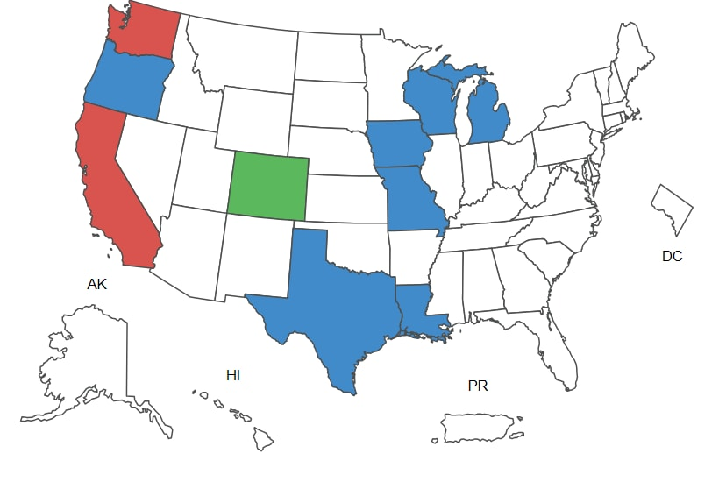
In Dairy Cattle
An outbreak of highly pathogenic avian influenza (Influenza A H5N1) ongoing in dairy cows in US since March 2024
16 states and 924 herds impacted
Multiple human infections from direct exposure to infected cattle
The recent death in Louisiana was from a different H5N1 strain than that infecting dairy cattle

Slide 19
Current Situation
While the current public health risk is low, CDC is watching the situation carefully and working with states to monitor people with animal exposures.

Slide 20
What does all this mean?
The wide geographic spread of HPAI A(H5N1) viruses in wild birds, poultry, and some other mammals, including in cows, could create additional opportunities for people to be exposed to these viruses.
The current risk to people is low.
Job related or recreational exposures to infected birds or other animals (including cows) constitutes the greatest risk to people

Slide 21
Recommendations for the Public
People should avoid unprotected (not using respiratory or eye protection) exposures to sick or dead animals including wild birds, poultry, other domesticated birds, and other wild or domesticated animals, as well as with animal feces, litter, or materials contaminated by birds or other animals with suspected or confirmed HPAI A(H5N1) virus infection.
People should not prepare or eat uncooked or undercooked food or related uncooked food products, such as unpasteurized (raw) milk, or raw cheeses, from animals with suspected or confirmed HPAI A(H5N1) virus infection (avian influenza or bird flu).

Slide 22
Thank you, and Questions

