Slide 1
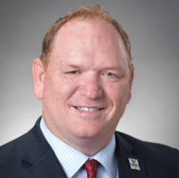
Youth & Mental Health:
Solutions to Connecting Families with Mental Health Struggles
MHAI| January 16, 2025
John Damon, PhD.
Chief Executive Officer
Canopy Children’s Solutions
John.damon@mycanopy.org
mycanopy.org

Slide 2
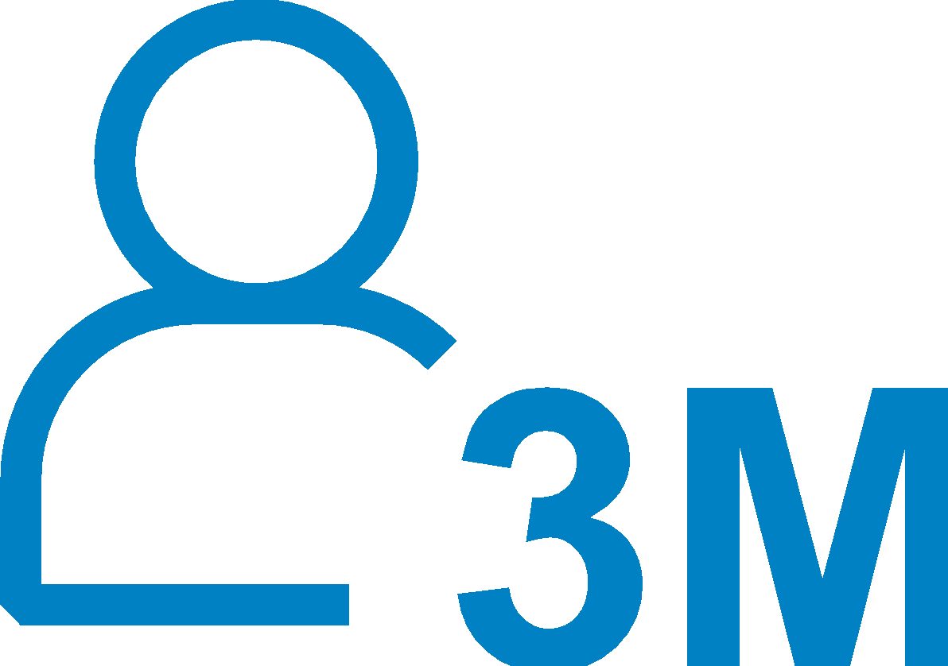
THE BATTLE OF HOPELESSNESS
U.S. Surgeon General warns that the nation is facing a public health crisis in caring for children and adolescents with behavioral, psychological, and emotional challenges.
The percentage of adolescents reporting at least one major depressive episode in the past year increased nearly 90%
Black children nearly twice as likely to die by suicide than White children
1 in 3 high school
students report persistent feelings of sadness or hopelessness
3 Million had serious thoughts of suicide
Nearly 3/4 of troubled youth do not get the care they need

Slide 3
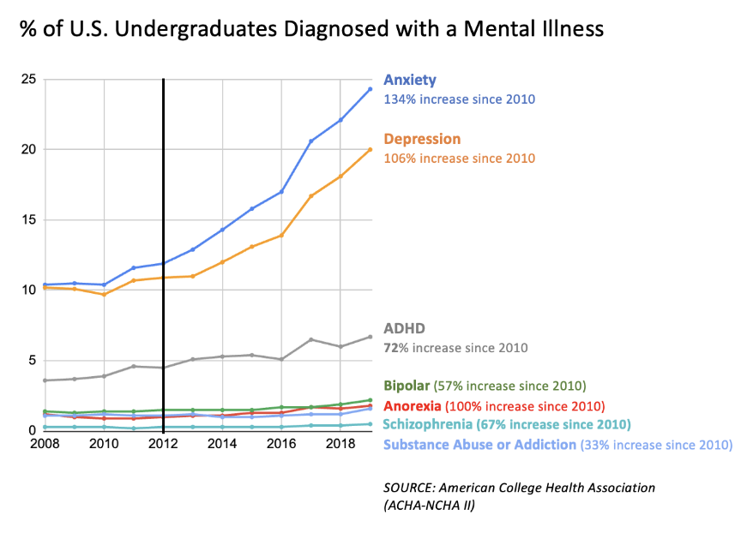

Slide 4
IT IS NOT WORKING
The current ecosystem is confusing and inaccessible for children in need, inefficient for providers and costly for those bearing risk.
CHALLENGES WE ARE SEEING:
Awareness and understanding
Access
Resources are siloed and reactive
Costs are rising

Slide 6
ABOUT CANOPY
Mississippi’s most comprehensive nonprofit provider of children’s behavioral health, educational and family support solutions.
Founded in 1912 as an adoption agency, Canopy has more than a century of impact serving Mississippi children and families.
Solutions are developed for Mississippi’s children, youth and families, and continue to evolve to meet society’s changing needs.
Canopy serves nearly 8,000 children plus their families annually across all 82 counties of Mississippi through a full range and continuum of innovative solutions.

Slide 8
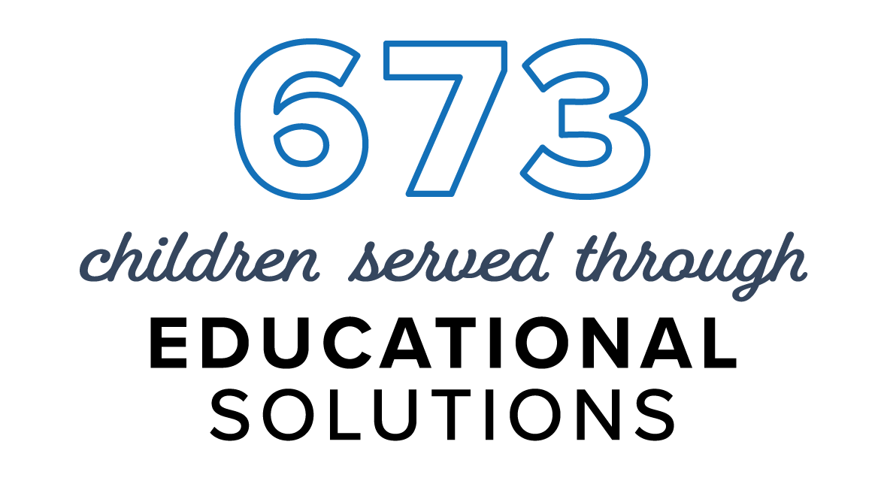
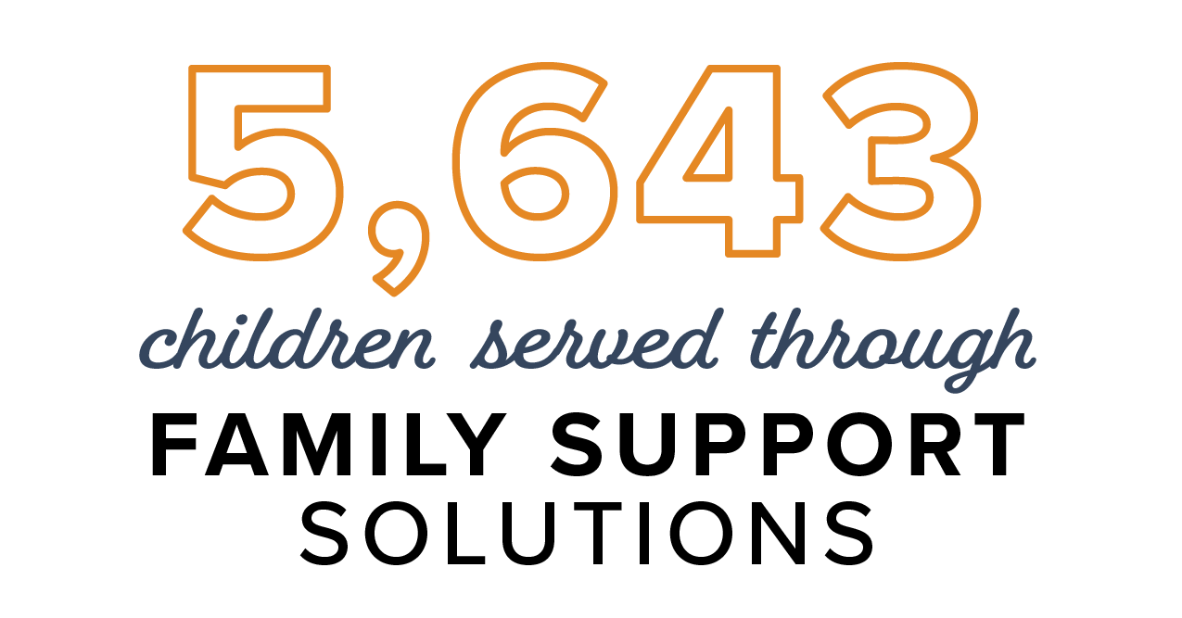
BEHAVIORAL
HEALTH
FAMILY
SUPPORT
EDUCATIONAL
Behavioral Health Clinics
CARES Center
Mississippi Youth Programs Around the Clock
Wraparound
Early Intervention Autism Clinic
CARES Schools
The Canopy School
Canopy Anywhere
in-CIRCLE
LINK
South Mississippi Child Advocacy Centers
Therapeutic Foster Care
Warren County Children’s Shelter
Adoption and Maternity Solutions

Slide 9
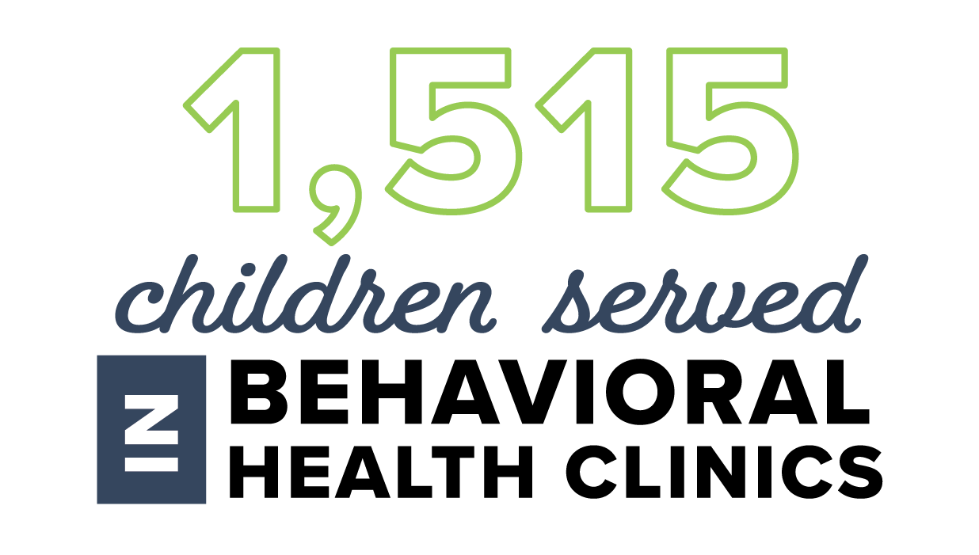
BEHAVIORAL HEALTH CLINICS
Serving children and youth ages 4 to 21 and offers a wide range of solutions for children and families including:
Convenient outpatient treatment for ADHD, depression, anxiety, trauma and other behavioral health challenges
Behavioral health evaluations
Individual and family therapy
Crisis management
Medication management
Psychiatric services
3 LOCATIONS:
GULFPORT, HATTIESBURG AND JACKSON

Slide 10
CARES Center
Intensive psychiatric residential treatment facility serving children and youth ages 6 to 17 with severe emotional and/or behavioral challenges.
60-bed, 24-hour care facility
Comprehensive services with a multidisciplinary team of psychiatrists, psychiatric mental health nurse practitioners, registered nurses, family nurse practitioners, therapists, dietary staff and case managers
Intensive individual, group and family therapy
Medical services
Therapeutic recreation
Education services and social skills training
JACKSON

Slide 11
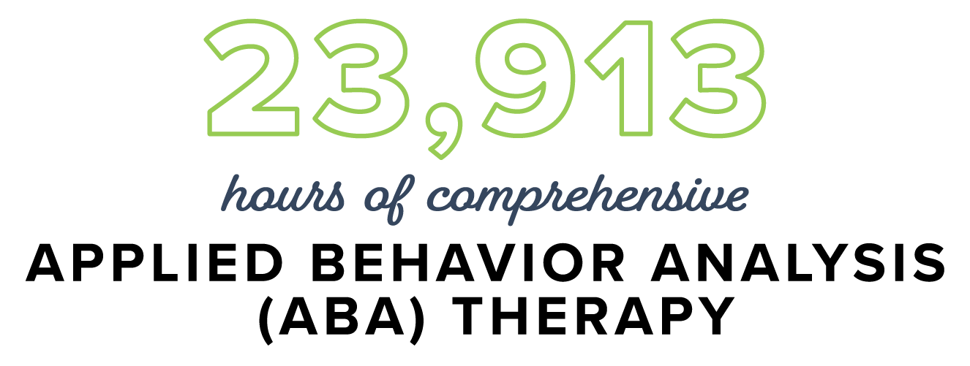
EARLY INTERVENTION AUTISM CLINIC
Early intervention autism therapy for children 18 months to 8 years old diagnosed with Autism Spectrum Disorder (ASD).
Applied Behavior Analysis (ABA) therapy
Promoting the Emergence of Advanced Knowledge (PEAK) language training system
Required individualized parent training for all families
In-service training for educators, social workers and related disciplines
Behavioral consultation for school districts and daycare centers
Provide comprehensive ABA assessment examining various aspects of child development such as language, behavior and what may serve as a motivation to learn
2 LOCATIONS:
JACKSON

Slide 12
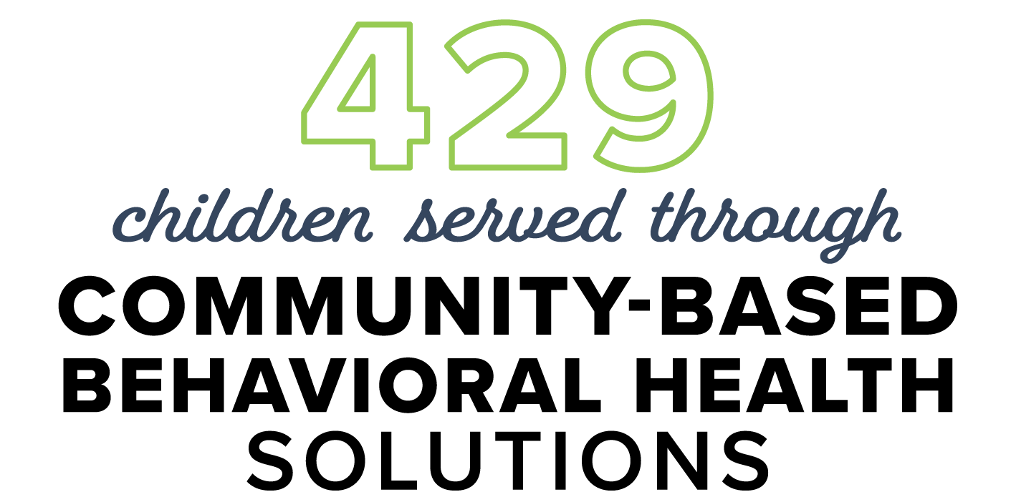
MISSISSIPPI YOUTH PROGRAMS AROUND THE CLOCK (MYPAC)
Intensive in-home and community-based behavioral health solution that is designed to keep youth thriving in the home as an alternative to residential care.
Crisis intervention 24 hours a day, 7 days a week
MYPAC services are designed specifically with the youth and their family in mind, and are tailored, measured and adjusted to meet the specific and unique needs of each family.
Psychiatric services
Individual and family therapy
Medication management
SERVING COMMUNITIES STATEWIDE

Slide 13
WRAPAROUND
Care coordination process that partners with children, youth and their families to connect them with resources to help them succeed long-term.
Family support for long-term success and collaboration for family goals and outcomes
Increase in healthy behaviors in the home, school and communities
Community support
Helps keep families together
SERVING COMMUNITIES STATEWIDE

Slide 14
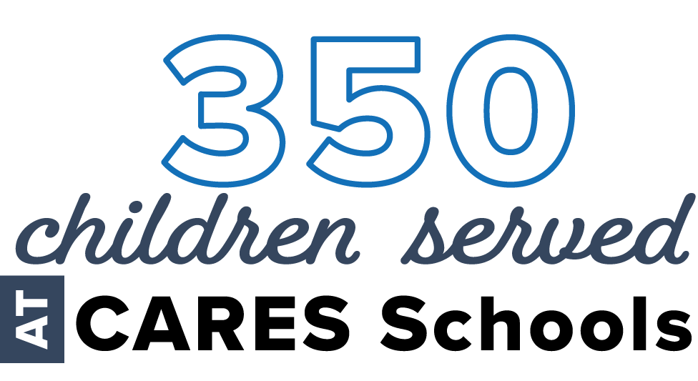
CARES School
Fully-accredited private, non-public, special purpose schools designed to meet the educational and behavioral needs of children whose behavior prohibits them from succeeding in a traditional classroom setting.
Grades 1 through 12
Small class sizes
Trauma-informed classrooms
Licensed teachers and Behavioral Educational Interventionists in each classroom
Intense, individualized educational and therapeutic services that meet the needs of each student
Specialized classrooms for children on the autism spectrum
Services designed to improve relationships at home and in the community
Access to a full continuum of services
Extended school year
Transportation provided by the student’s school district
3 LOCATIONS:
HATTIESBURG, JACKSON & BILOXI
SERVING 32 SCHOOL DISTRICTS

Slide 15
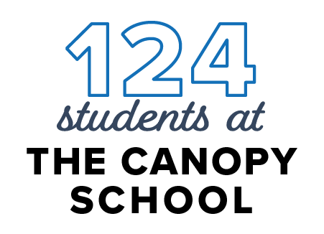
THE CANOPY SCHOOL
Nonprofit, fully-accredited school that empowers the diverse abilities of children through an individualized approach to education in a supportive, innovative and transformative environment.
Grades K-12 plus Workforce Readiness Program
Open Enrollment
Support Services benefit students with learning differences and other special needs, and includes:
Dyslexia therapy
Speech therapy
Occupational therapy
School and clinical mental health counseling
Applied behavior analysis
RIDGELAND

Slide 16
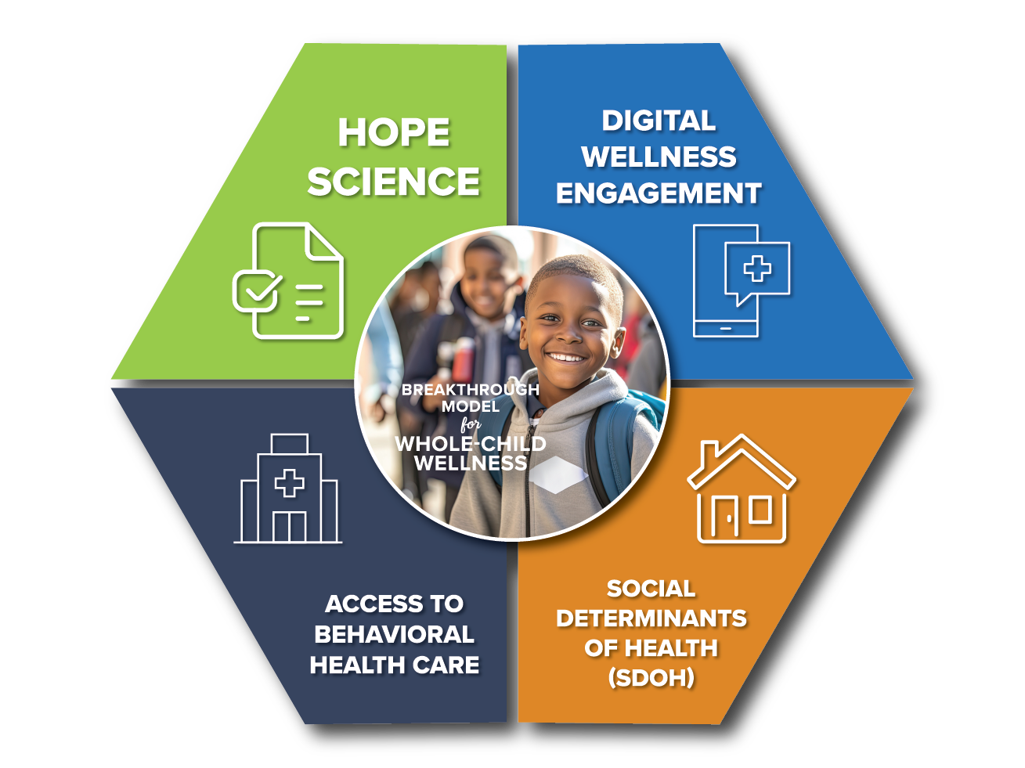
Evidence-based
Proactive Wellness Framework
Toolkit for Youth
Resiliency Builder
AI-driven Outreach & Enrollment
Digital Education & Resources
Progress Reporting & Tracking
Canopy Anywhere provides comprehensive mental healthcare services for youth via proactive, tech-enabled outreach, screening and navigation, self-guided digital resources and coaching and coordinated access to physician resources. The solution offers a highly scalable, cost efficient model that aims to reach all youth within the target age rang and deliver measurable outcomes, return on investment and healthcare cost savings.
Screening and Triage
Curated Care Navigation
Digital Cognitive Behavioral Therapy
24/7 Clinical Coaching
Telehealth and In-Person Delivery
Screening for SDOH
Resources and Education for Family Support Systems
Digital & Physical Resource Navigation

Slide 17
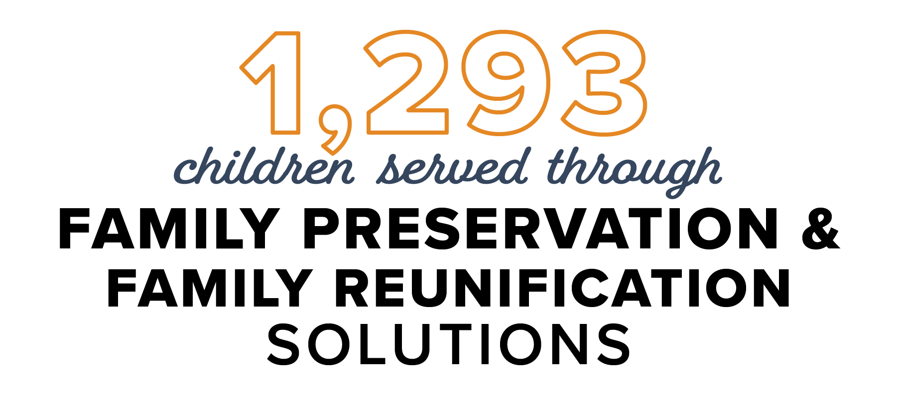
in-CIRCLE
Comprehensive home and community-based family preservation, reunification and support solution for families.
Crisis intervention (24 hours a day, 7 days a week)
Child and family team meetings
Individual and family therapy
Case management
Trauma-focused therapy
Parenting and life skills training
Family advocacy
Peer support services
Evidence-based assessments and interventions
Wraparound services available
SERVING COMMUNITIES STATEWIDE
Funded by a grant from the Mississippi Department of Child Protection Services

Slide 18
SOUTH MISSISSIPPI CHILD ADVOCACY CENTERS
Serving child victims ages 3 to 18, vulnerable adults and their families along the Mississippi Gulf Coast.
Safe environments for child abuse or neglect victims to share their experiences only once with a trained team to begin the investigation and healing process
Forensic interviews
Access to community resources
Court preparations for families
Court testimony
Mental health solutions
Community outreach
Victim advocacy
Multidisciplinary Team reviews
2 LOCATIONS:
GULFPORT AND PASCAGOULA
Serving George, Green, Harrison, Jackson and Stone Counties

Slide 19
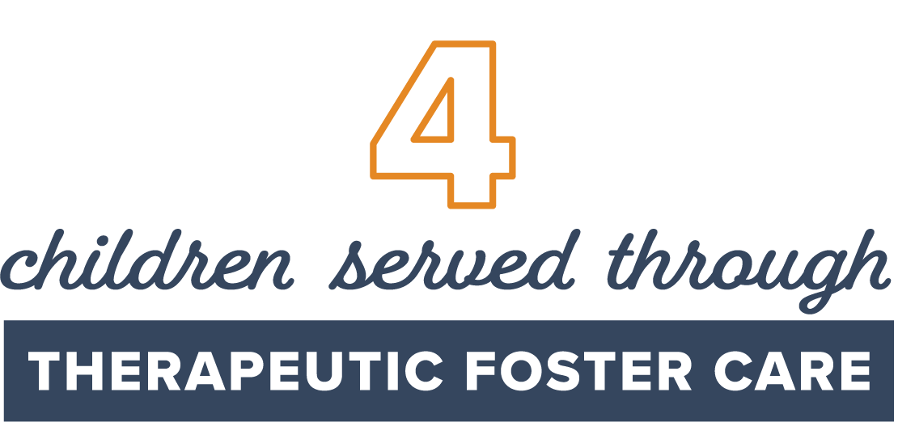
THERAPEUTIC FOSTER CARE & ADOPTION
Therapeutic Foster Care
Adoption & Maternity Solutions
Home-based solution for children with special emotional, behavioral and medical needs
Licensed Canopy therapeutic foster care parent training
Financial compensation
Support through Canopy includes:
Crisis intervention
Therapy
Training
Resources
Birth search
Home study
Adoption planning
Adoption placements
SERVING COMMUNITIES STATEWIDE
HATTIESBURG

Slide 20
WARREN COUNTY CHILDREN’S SHELTER
Emergency shelter providing diagnostic/evaluation services for abused, neglected, runaway and homeless children and youth.
Children and adolescents ages 17 and younger
Registered National Safe Place providing a warm, home-like environment
Admissions available 24 hours a day, 7 days a week
Residents have access to the following services while at WCCS:
Medical, dental, vision and psychological care
Crisis intervention
Individual counseling and group counseling
Case management
Behavioral management
Aftercare counseling services
Educational and life skills support
Recreational activities
Partnership with the National Runaway and Homeless Youth Program
VICKSBURG

Slide 21
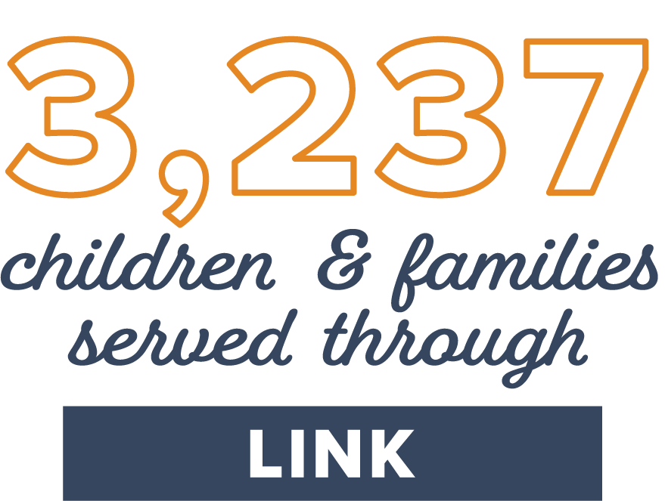
LINK
Connects families with state, local and federal community resources to help prevent families from ending up in situations that lead to childhood trauma.
Resource areas include:
Financial Assistance
Mental and Behavioral Health Treatment
Employment Assistance
Parenting Education
Food Assistance
Childcare Assistance
Financial Literacy
Transportation Assistance
Provides FREE Community Education Classes on:
Active parenting
Parenting skills
Teen pregnancy prevention
Substance abuse
Child development
Domestic violence prevention
Mental health
Suicide prevention
Child abuse/neglect awareness
FREE to all Mississippi families
SERVING COMMUNITIES STATEWIDE
Funded by a grant through the Mississippi Department of Human Services

Slide 22
IT IS NOT WORKING
The current ecosystem is confusing and inaccessible for children in need, inefficient for providers and costly for those bearing risk.
CHALLENGES WE ARE SEEING:
Awareness and understanding
Access
Resources are siloed and reactive
Costs are rising

Slide 23
A Breakthrough Strategic Partnership Among Three Industry Leaders
Three founding network partners to provide proven core technology, digital programs, and healthcare services as well as trusted relationships across Mississippi
Digital Outreach & Care Management
GetWell works with over 500 health systems and hospitals across the US. Our engagement platform combines automated consumer communications with intelligent staff workflow to engage children and their families, assess their needs, and navigate them to the right resources at the right time.
Canopy Children’s Solutions’ mission is to help children thrive and families overcome extraordinary challenges by providing a continuum of behavioral health, educational and social service solutions.
One of Mississippi’s oldest and largest nonprofit organizations, serving throughout the state for 110 years
Mental and behavioral health clinic-based, in-home education, and community based solutions
24-hour residential solutions
Autism solutions
Crisis solutions
Behavioral health and neurodiversity focused educational solutions
Serving 7,500 Children in MS Annually
Touching 10M Patients Annually
Digital Behavioral Health Care
Learn to Live provides highly interactive, self-directed CBT programs plus comprehensive homework/activities for: depression, insomnia, panic, resilience, social anxiety, stress, anxiety & worry, and substance use.
Covering 35M Members Annually

Slide 26
CANOPY ANYWHERE OVERVIEW
A tech-enabled mental health solution that screens, educates, and engages youth and their guardians based on their specific mental health needs.
ACTIVATE & ENROLL
MEDICAL PROVIDERS
Multi-channel outreach
COMMUNITY
ORGANIZATIONS
SCREENING & CARE JOURNEYS
SDOH, Hope screening & clinically validated personalized learning
SCHOOLS
NAVIGATE
Based on risk profile, path to appropriate resources
INSURERS
OPTIONAL LIVE SUPPORT
Live Virtual Navigators available

Slide 27
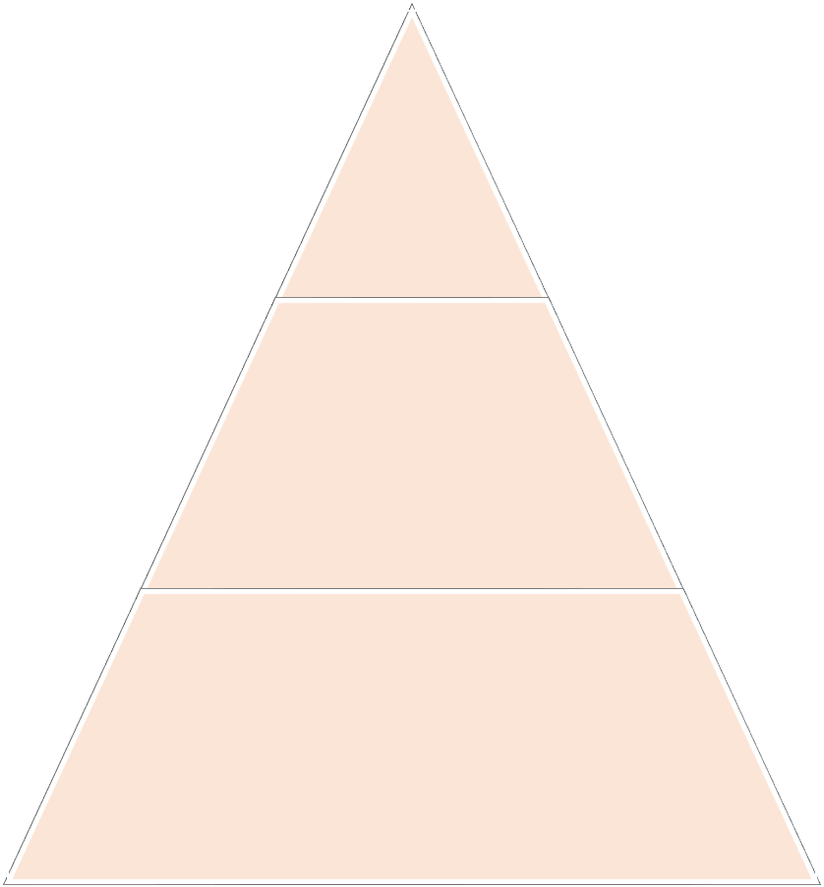
Turnkey, Scalable Tech-Enabled Service to Generate Hope at Scale and Deliver Comprehensive Mental Health & Well-Being
Wellness
Outreach & Assess
Warning
Hi Michael! This is Hope, your digital wellness assistant. You've been enrolled in a free program by your school designed to help you feel your best. In order to provide you with the best support and resources, I would like to ask you some questions to get to know you better. Tell us more about yourself here: https://cf.org/hope
Need
Ongoing wellness, hope, and when necessary, triage and navigation of youth to partner programs and services
Sounds good. I’ll take a look now.

Slide 33
TAPPING INTO THE SCIENCE (AND POWER) OF HOPE
What is Hope?
Hope is a belief that your future will be better than today, and that you have the power to make it happen.
Three Tenants of the Science of Hope
GOALS: Deeply meaningful goals set by the youth and family
PATHWAYS: Mental roadmaps to goal attainment
WILLPOWER: Mental energy to pathway pursuits
A goal without a pathway is just a wish.

Slide 34
TAPPING INTO THE SCIENCE (AND POWER) OF HOPE
Hope is the single most predictive indicator of well-being in a person’s life. Canopy Anywhere will prescribe and deliver hope to a generation of youth with personalized plans designed to meet their needs and ongoing support to ultimately change the trajectory of their lives.

Slide 35
TAPPING INTO THE SCIENCE (AND POWER) OF HOPE
Canopy Anywhere fills a gap and gives Hope to youth and families.
Hope is a:
Predictor of academic achievement (attendance, grades, test scores, GPA, graduation rates and college enrollment)
Critical protective factor to help recover from mental illness
Predictor of ability to adapt, self-regulate emotions, thoughts and behaviors

Slide 37
CANOPY ANYWHERE
PILOT RESULTS
Key Pilot Metrics for Madison County School District
June 2024

Slide 41
COST-EFFECTIVELY MEETING KIDS WHERE THEY ARE
Current gaps in school-based mental health services.
Best-practice provider-to-student ratios
Current MS provider-to-student ratios
Guidance counselor to student = 1:250
Social worker to student = 1:250
School psychologist to student = 1:500
Nurse to student = 1:750
Guidance counselor to student = 1:432 (1.75x)
Social worker to student = 1:4,956 (20x)
School psychologist to student = 1:1,211 (2.4x)
Nurse to student = 1:942 (1.25x)
Mississippi DoE would need to spend an additional $223,353,903 to hire and
train resources to meet recommended staffing levels.

Slide 42
LET’S COLLABORATE

Slide 43
MYCANOPY.ORG
Questions?

