Slide 1
Mississippi Health Ambassadors
Thomas Dobbs, MD, MPH
12/19/2024

Slide 2
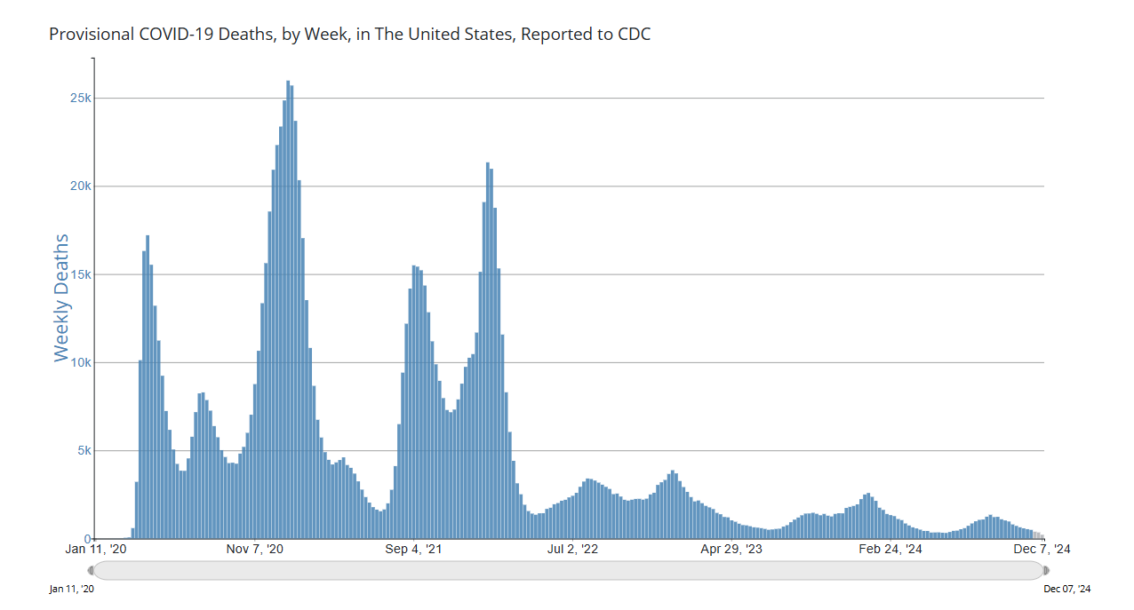

Slide 3
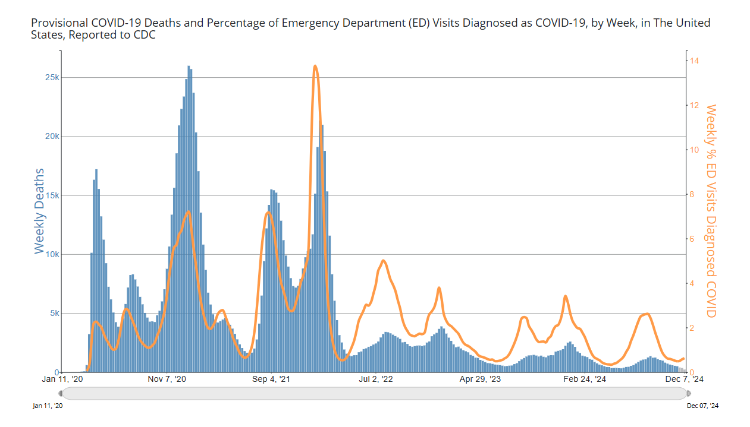

Slide 4
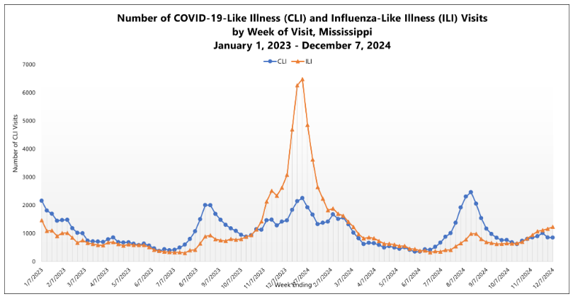

Slide 5
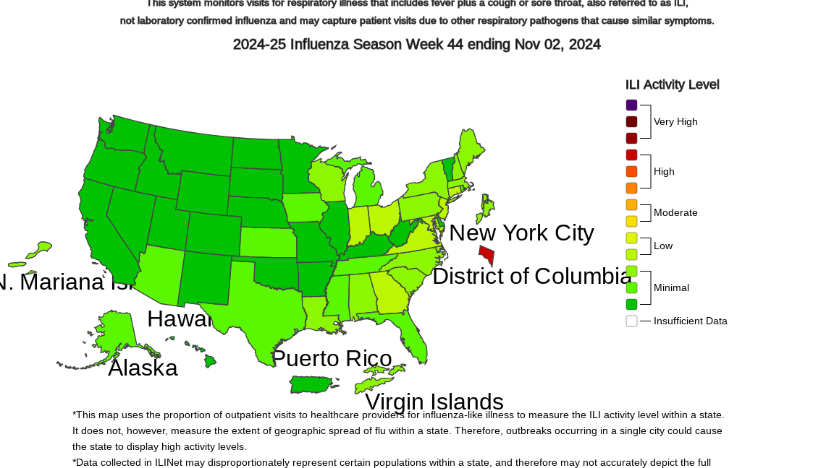

Slide 6
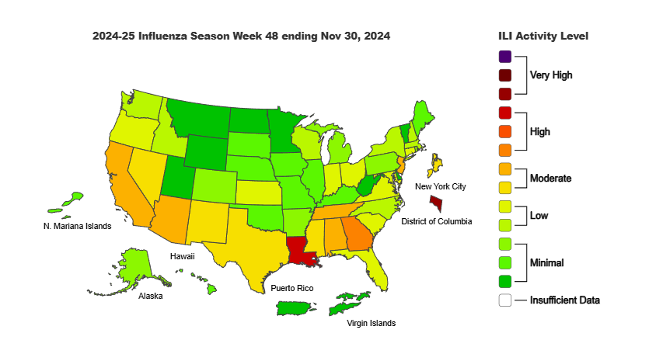

Slide 7
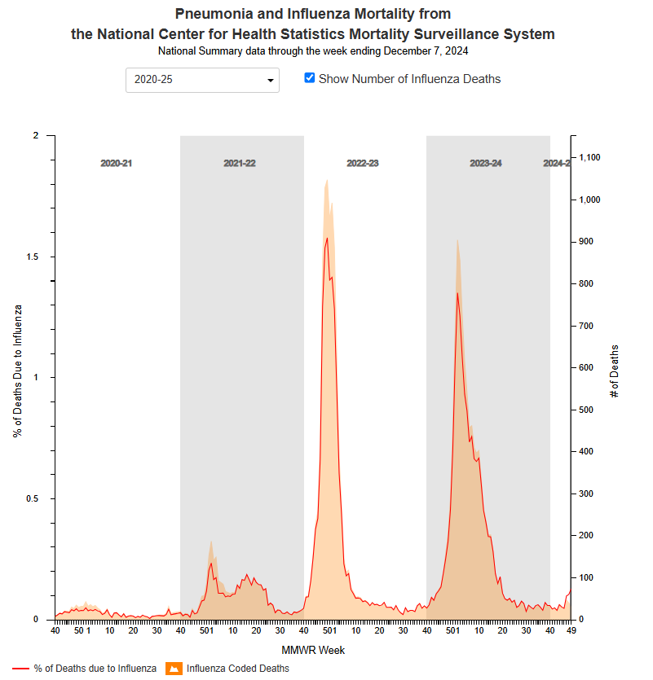

Slide 8
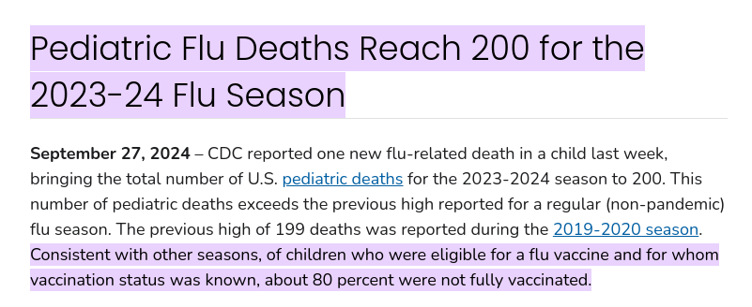
Vaccine Recommendations
COVID Vaccines
  Pfizer/Moderna - available for 6 and older
  Novavax – 12 and older
  Highly recommended for those 65+ or chronic medical issues
Flu Vaccines
  Recommended 6 months and older
  High dose recommended for 65+ or with certain immunosuppression

Slide 9
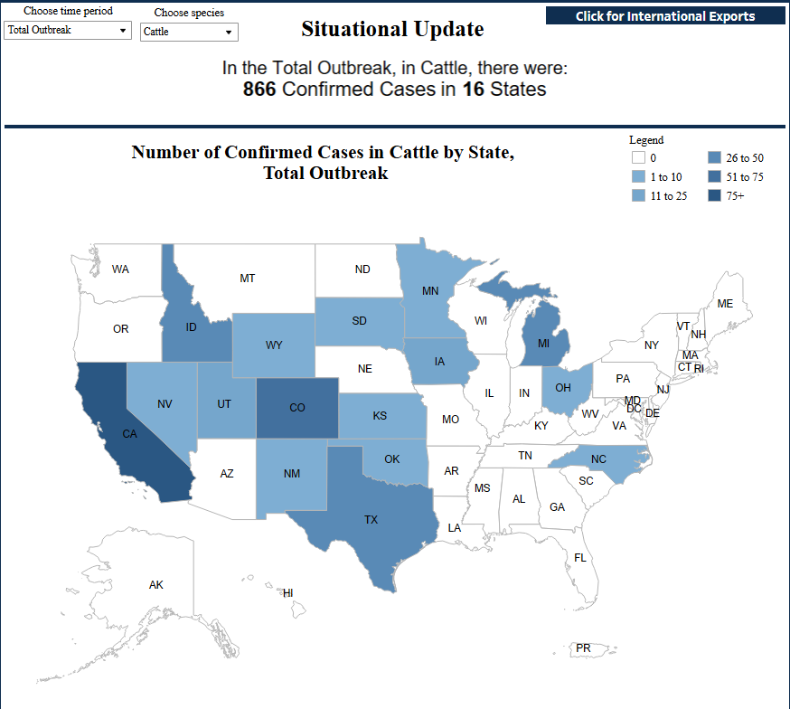

Slide 10


