Slide 1
Office of Preventive Health and Health Equity “Office of Health Equity
Nikki Johnson, DrPH, MPH
Director, Special Projects, Office of Preventive Health and Health Equity
COVID-19, Health Disparity Response Unit
Coordinator, Preventive Health and Health Services CDC Block Grant

Slide 2
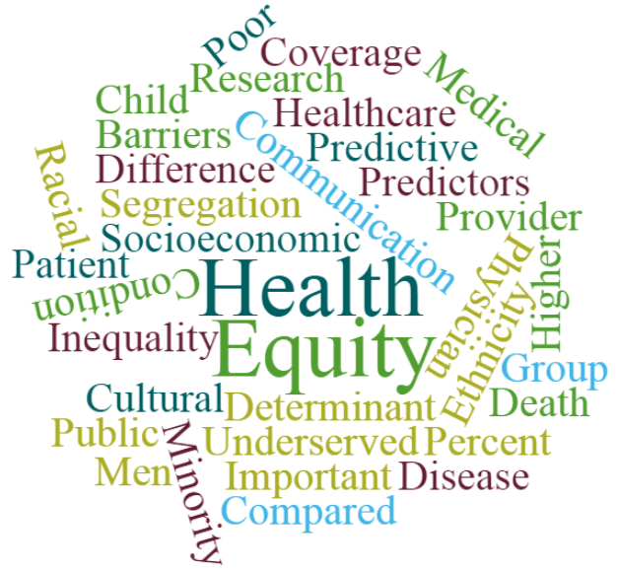
Health Equity
Language Access
CEAL (Community Engagement Research Alliance)
Health Equity Modules and Cultural Competency Trainings
Emergency Response
Community-based Initiatives
Faith-based Initiatives

Slide 3
Community-based Initiatives
Goal is to expand the capacity of MSDH to address health disparities related to the social determinants of health and advance overall health equity within the state.
Demonstration projects aimed at allowing Mississippi residents the opportunity to attain their full health potential (i.e., achieve health equity).

Slide 4
Awardees
Boat People S.O.S
Central Mississippi, Inc.
El Pueblo
Fannie Lou Hamer Breast Cancer Foundation
Jackson State University
Mississippi Immigrants' Rights Alliance
Mississippi Minority Farmers Alliance
Mom.ME
Operation Shoestring, INC
Refill Cafe dba Refill Jackson Initiative
The Church Triumphant Global
University of Mississippi

Slide 5
Faith-based Initiatives
Goal is to expand the capacity of churches with health ministries to enhance and increase knowledge as it pertains to preventive health and addressing the needs of congregates and the broader community.

Slide 6
Language Access
Interpretation and Translation Services for the agency
Trainings
Hispanic Task Force
Vietnamese Task Force

Slide 7
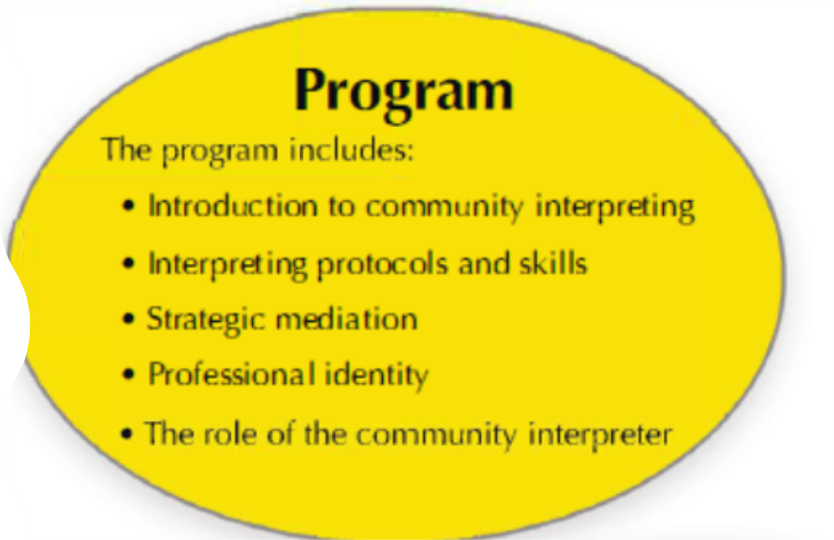
Community and Medical Interpreter Training

Slide 8
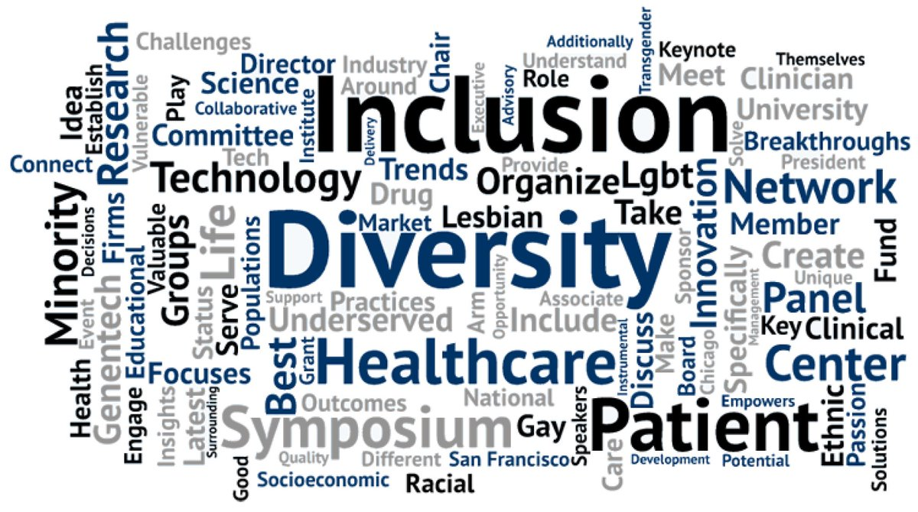
Health Equity Training Series
A series of 5-modules that develop the capacity to communicate a social, economic, and environmental approach to health experiences and outcomes. Participants increase health equity competency and identify opportunities to operationalize strategies to advance health equity in everyday work activities.
Module 1: What is Health Equity
Module 2: Defining Social Determinants of Health
Module 3: Title VI Compliance
Module 4: Navigating Differences through Cultural Competency
Module 5: Cultural Inclusion and Unconscious Bia

Slide 9
Cultural Competency Training
Reinforces the importance of diverse services for families and highlights the significance of helping professionals better serve and relate to all patients with unique cultures, heritages, languages, beliefs, and circumstances with the recognition that cultural responsiveness is an ongoing part of continuous quality improvement.

Slide 10
Emergency Response
Health Equity serves on the agency’s Incident Command and Senior Advisory Committee.
Work with incident personnel and organizations that are assisting or cooperating with public health emergencies. Contributing to an incident’s prevention, protection, mitigation, response, and recovery.
Health Equity serves as a link and liaison between health and social services programs and communities to provide timely and effective information during public health emergencies.

Slide 11
CEAL
Objectives:
Advance health and well-being of Mississippi’s populations are experiencing racial, ethnic, and socioeconomic disparities.
Enhance the resilience and power within communities to disseminate and implement evidence-based interventions.
Focus on improving maternal health outcomes, especially among Black women. The project seeks to

Slide 12
Contact Information
Office of Health Equity
601-206-1050
health.equityoffice@msdh.ms.gov
Nikki.Johnson@msdh.ms.gov

