Slide 1
Mississippi Health Ambassadors
Thomas Dobbs, MD, MPH
8/15/2024

Slide 2
COVID Update

Slide 3
Deaths

Slide 4
Cumulative Deaths

Slide 5
FLiRT Variants
Family of Viruses that have specific mutation that help the virus evade pre-existing immunity
Any variant with KP or JN
Illness
Some cross protective immunity / incomplete
Mostly mild / some serious
Similar symptoms

Slide 6
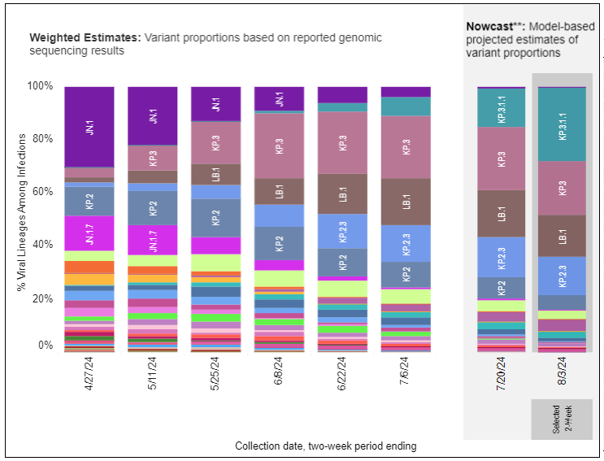

Slide 7
New Isolation Guidelines from CDC

Slide 9
Vaccines
New vaccine on the horizon Fall 2024
FDA – recommends JN.1 lineage, KP.2
Expect to see both mRNA vaccines and protein subunit
Recommended essentially for all > 5 years of age
Specific emphasis for age 65 or above or chronic illnesses
> 4 months from previous

Slide 10
COVID Vaccine Associated with Reduction in Long COVID

Slide 11
Key Messages
Stay home when you are sick
Treatment is still available
Paxlovid and other treatments still effective
Be ready for the 2024 vaccines

Slide 12
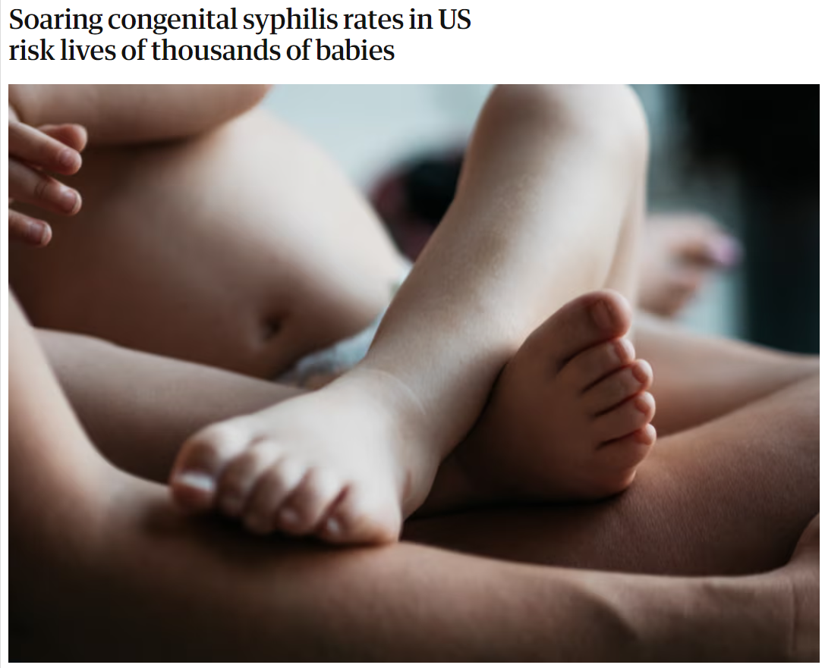
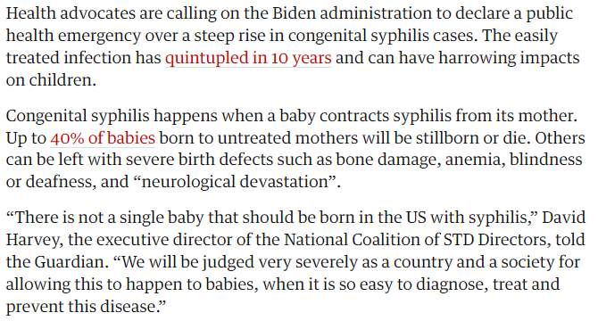

Slide 13
Stats
Between 2017 and 2021 MS saw a 6400% increase in reported cases of congenital syphilis
~40% of babies untreated in pregnancy will die (miscarriage, still birth, infant death)
Most can be cured with a single shot of penicillin

Slide 14
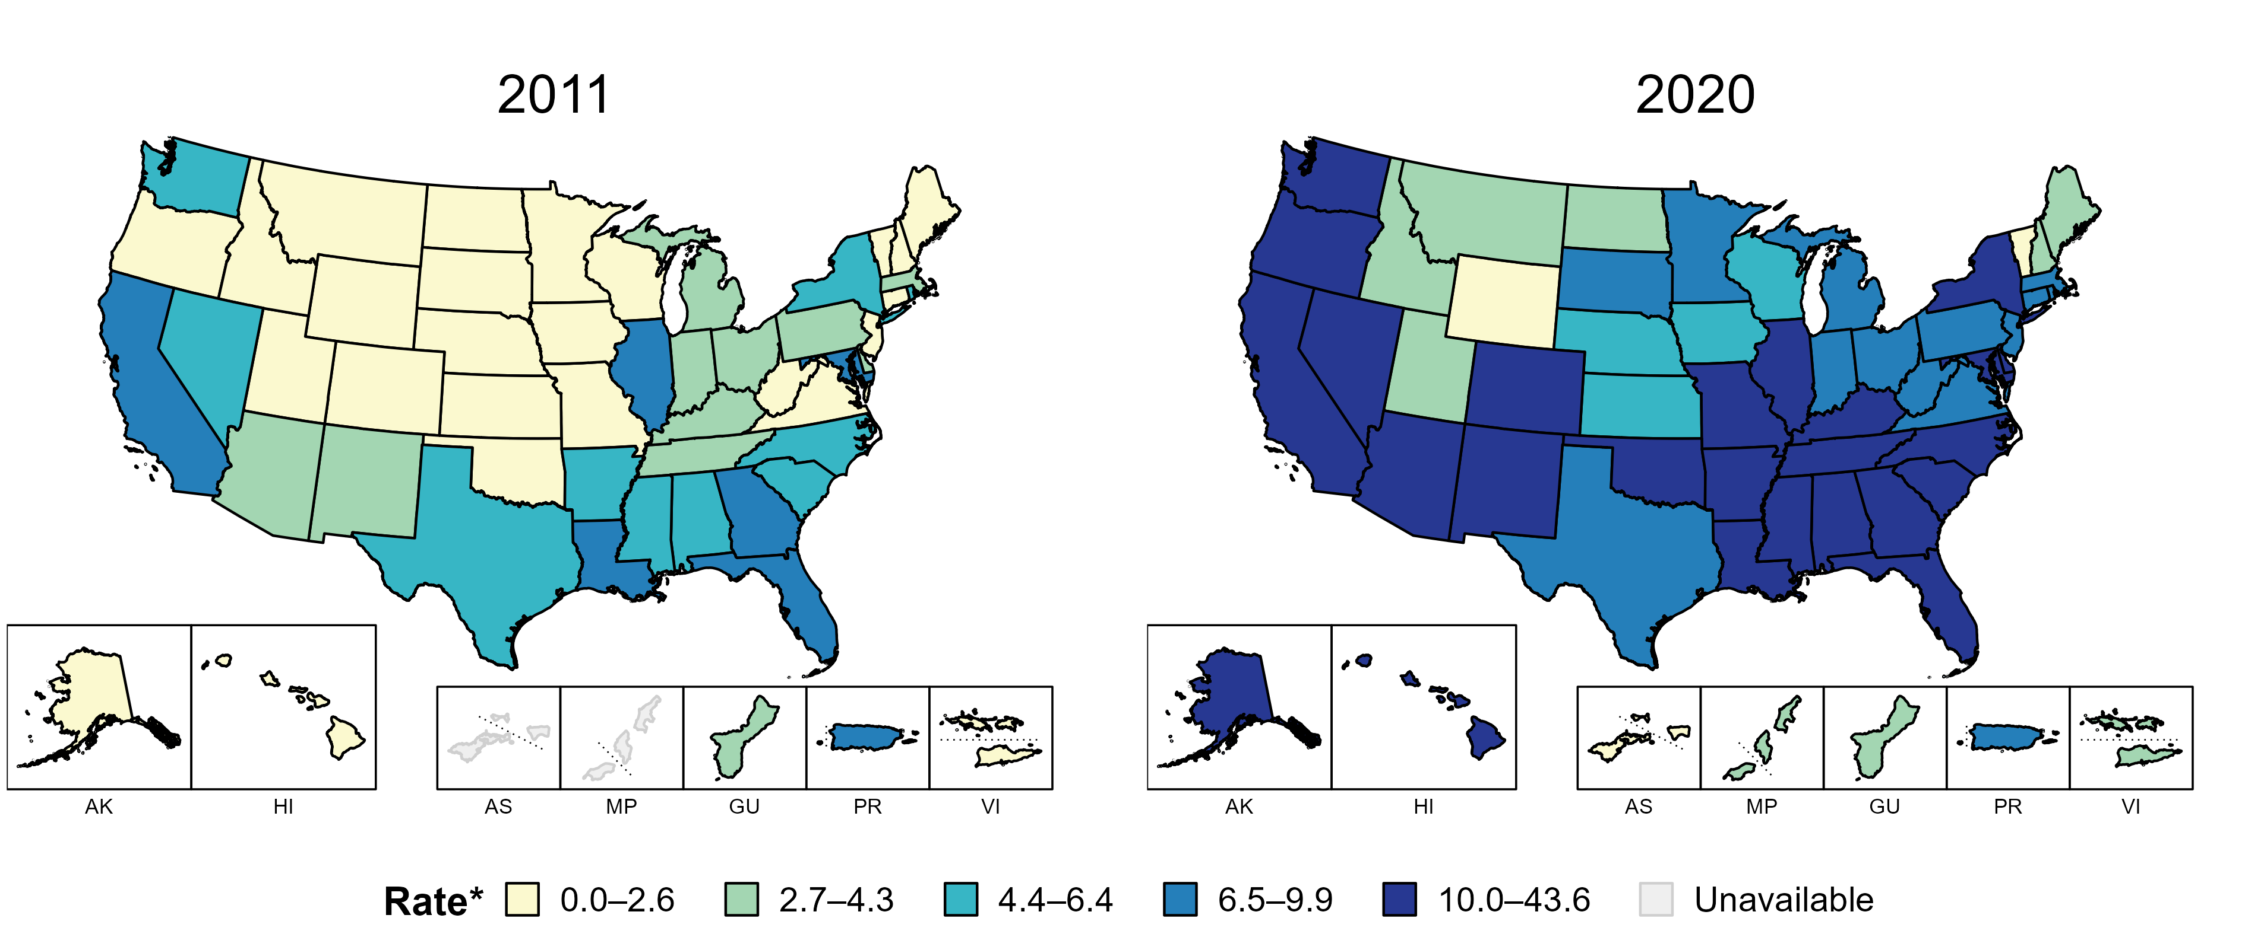
Primary and Secondary Syphilis — Rates of Reported Cases by State, United States and Territories, 2011 and 2020
* Per 100,000
Notes:
In 2011, six states, the District of Columbia (DC), and one US territory (14.3% of available areas) had a rate of reported primary and secondary syphilis greater than or equal to 6.5 cases per 100,000 population. This increased to 38 states, DC, and one US territory (71.4% of available areas) in 2020.
American Samoa and the Commonwealth of the Northern Mariana Islands began reporting data on primary and secondary syphilis cases to CDC in 2018; data are not available for those areas prior to that year.
The COVID-19 pandemic has introduced uncertainty and difficulty in interpreting 2020 case data. See Impact of COVID-19 on STDs (https://www.cdc.gov/std/statistics/2020/impact.htm) for more information.
See Technical Notes (https://www.cdc.gov/std/statistics/2020/technical-notes.htm) for information on syphilis case reporting and on interpreting reported rates in US territories.
Data points are available at: https://www.cdc.gov/std/statistics/2020/data.zip

Slide 15
Primary and Secondary Syphilis | 2021 | All age groups | All races/ethnicities | Both sexes | United States
Footnotes: NA - Not Applicable.

Slide 16
Congenital Syphilis | 2021 | All age groups | All races/ethnicities | Both sexes | United States
Footnotes: NA - Not Applicable.

Slide 17
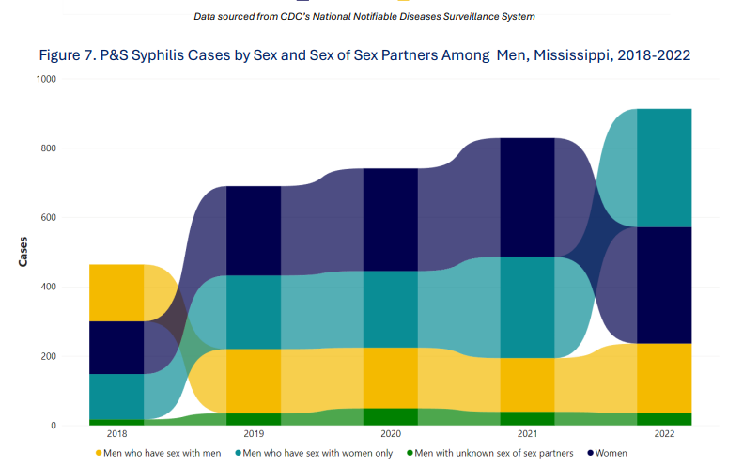

Slide 18
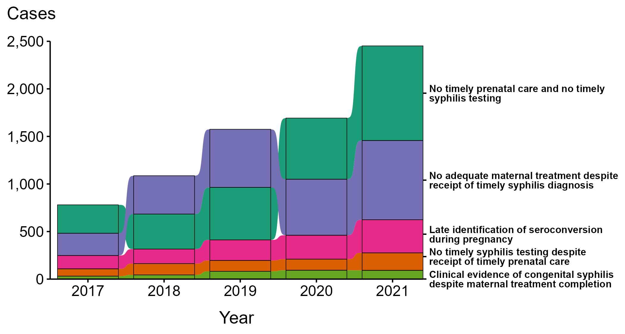
Congenital Syphilis — Missed Prevention Opportunities among Mothers Delivering Infants with Congenital Syphilis, United States, 2017–2021
NOTE: Of the 9,141 congenital syphilis cases reported during 2017 to 2021, 1,553 (17.0%) were not able to have the primary missed prevention opportunity identified due to insufficient information provided to CDC related to maternal prenatal care, testing, or treatment.
Notes:
In 2021, there were a total of 2,855 cases of congenital syphilis reported for a rate of 77.9 per 100,000 live births.
During 2017 to 2021, the majority of missed prevention opportunities among mothers of infants with congenital syphilis were those with no timely prenatal care or syphilis testing (n = 2,857; 38%) and timely syphilis testing but no adequate maternal treatment (n = 2,670; 35%). In 2021, the most common missed congenital syphilis prevention opportunity was mothers who had no timely prenatal care or syphilis testing (n = 995; 41%), followed by those who had timely syphilis testing but no adequate maternal treatment (n = 833; 34%).
The COVID-19 pandemic has introduced uncertainty and difficulty in interpreting STD data collected during 2020 and 2021. See Impact of COVID-19 on STDs (https://www.cdc.gov/std/statistics/2021/impact.htm) for more information.
See Technical Notes (https://www.cdc.gov/std/statistics/2021/technical-notes.htm) for information on syphilis case reporting.
Data points are available at https://www.cdc.gov/std/statistics/2021/data.zip.

Slide 19
Syphilis Testing and Treatment "System"
Pregnancy
Prenatal Care
Syphilis Testing
Syphilis Treatment
Repeat Testing
Partner Treatment
Treatment

Slide 20
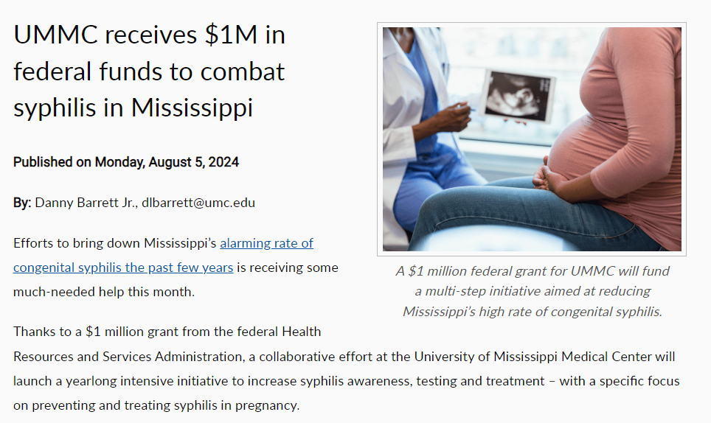

Slide 21
Diminishing Barriers to Success
Community Testing
And Treatment
Health Dept Partnership
Media Campaign
Med Outreach
Medicaid
Case Management
Service Mapping
ER Testing
Outreach
Hotline
Linkage
Pregnancy
Prenatal Care
Syphilis Testing
Syphilis Treatment
Repeat Testing
Partner Treatment
Treatment

Slide 22
To Do List
Please raise awareness
Forward stories in media
Like/Forward Social Media
Please follow MSDH and UMMC / others
Twitter: @BowerSOPH; @msdh
Facebook: UMMC Bower School of Population Health; Mississippi State Department of Health
Instagram: ummc_soph; healthy.ms

