Slide 1
COVID-19 Brief Update-MS Health Ambassador Initiative
Paul Byers, MD Associate Professor
Department of Preventive Medicine
John D. Bower School of Population Health
University of Mississippi Medical Center
July 18, 2024

Slide 2
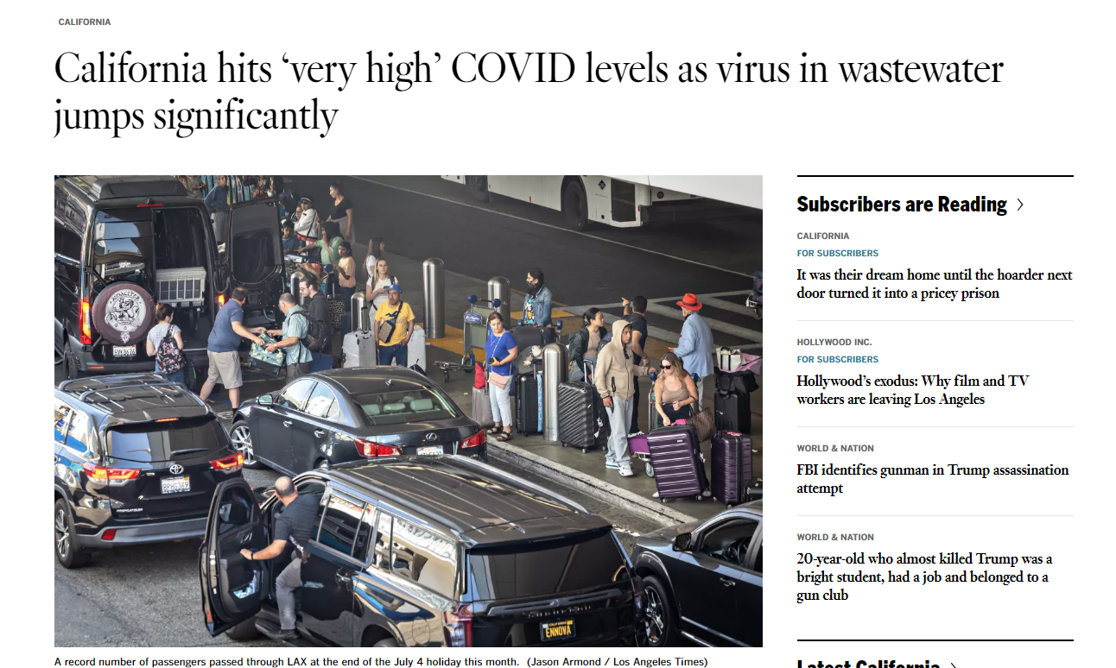
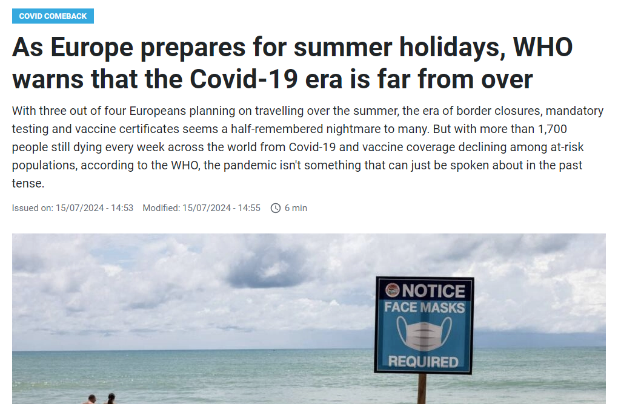
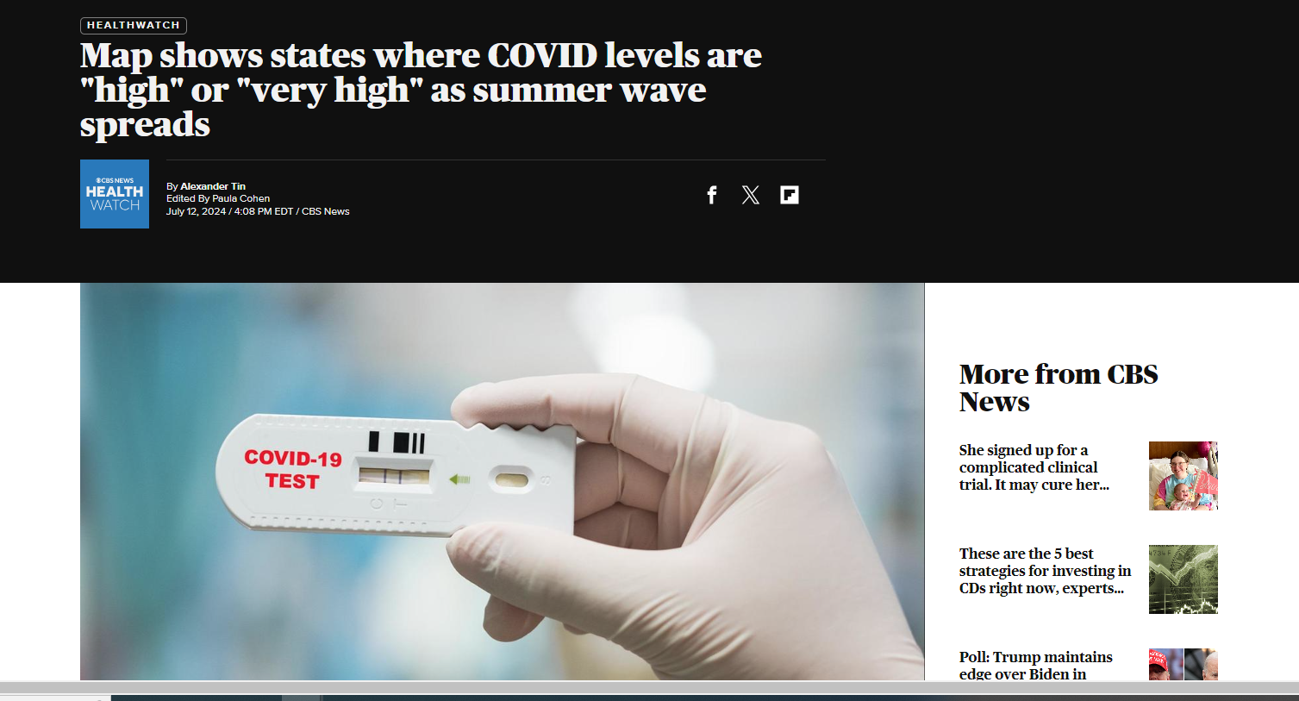

Slide 3
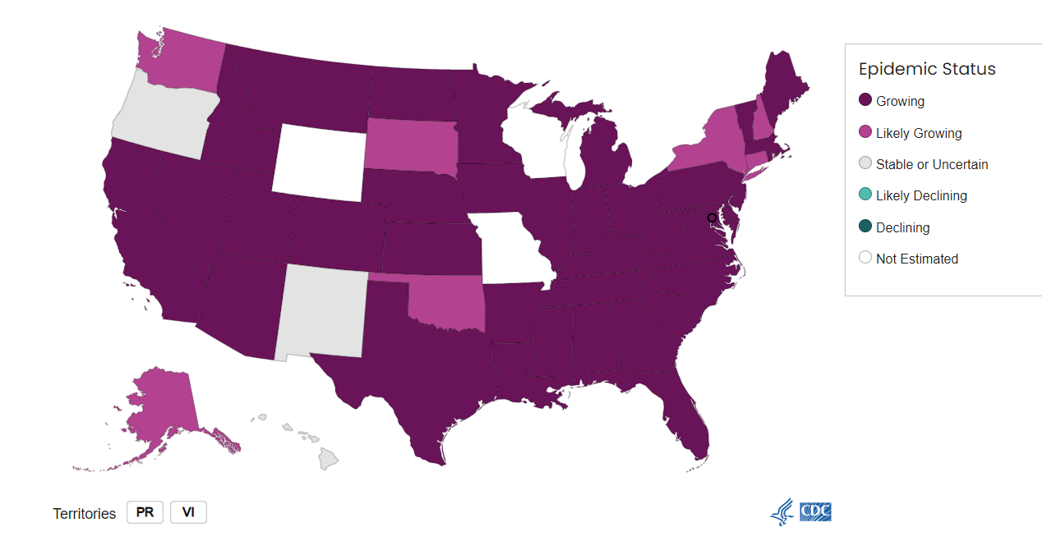

Slide 4
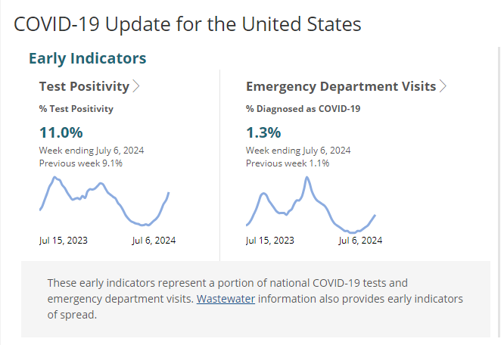

Slide 5
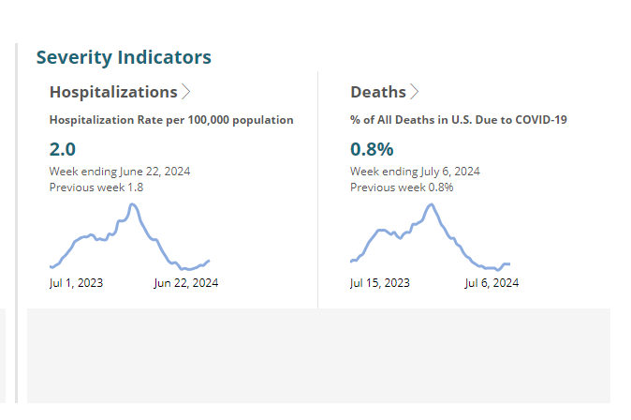

Slide 6
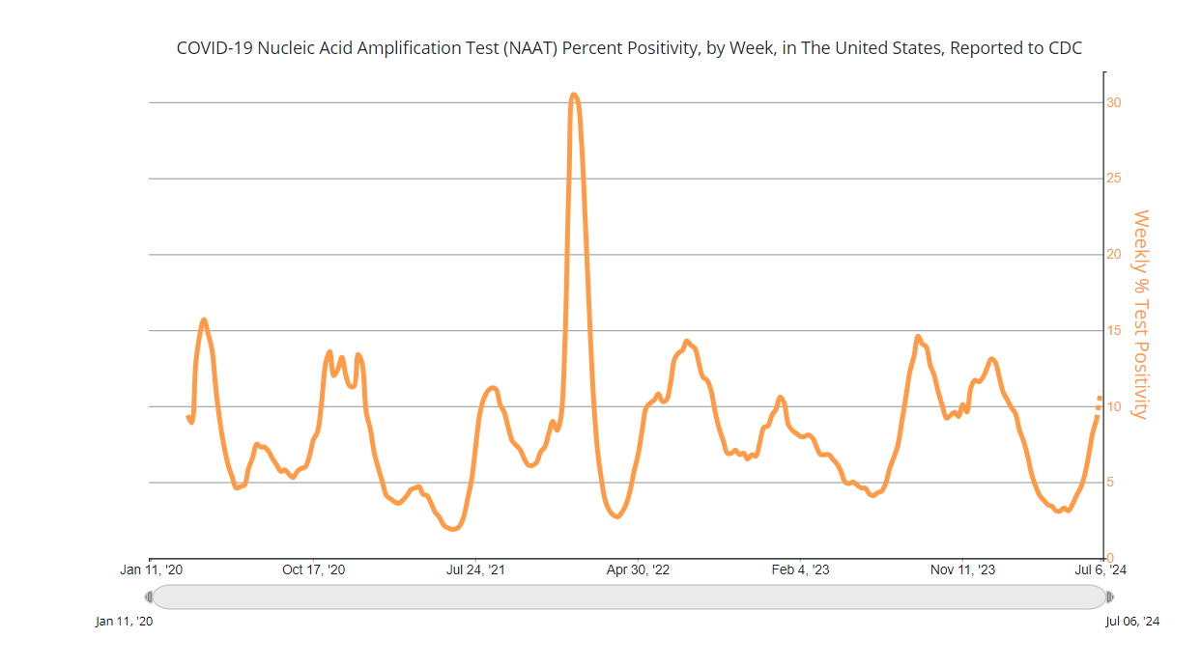

Slide 7
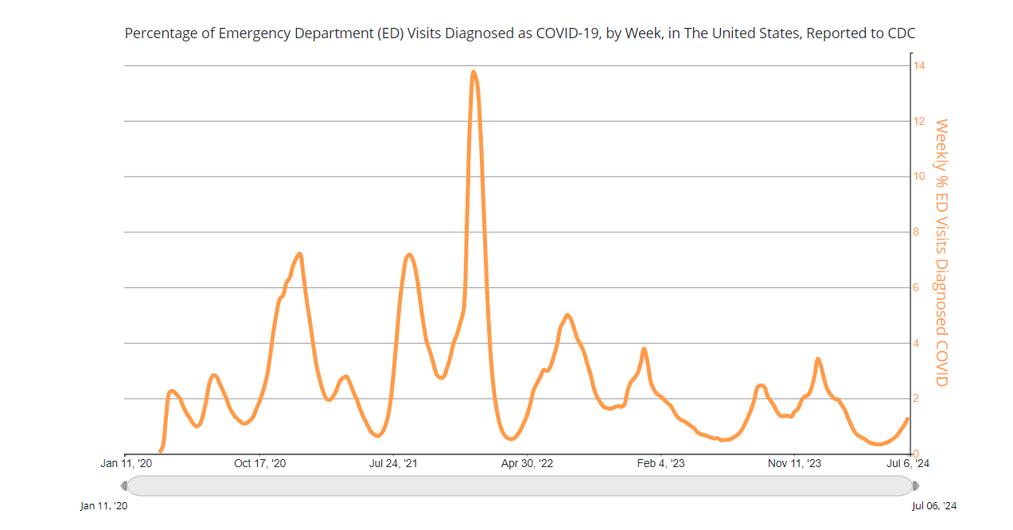

Slide 8
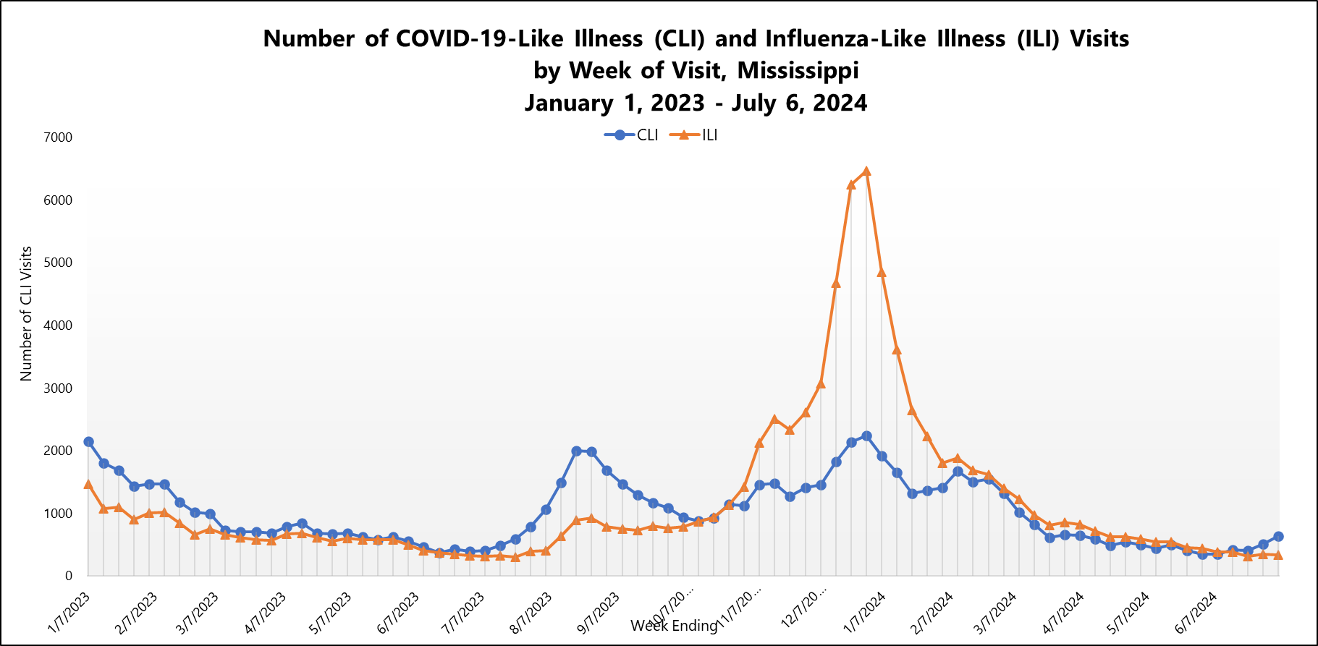

Slide 9
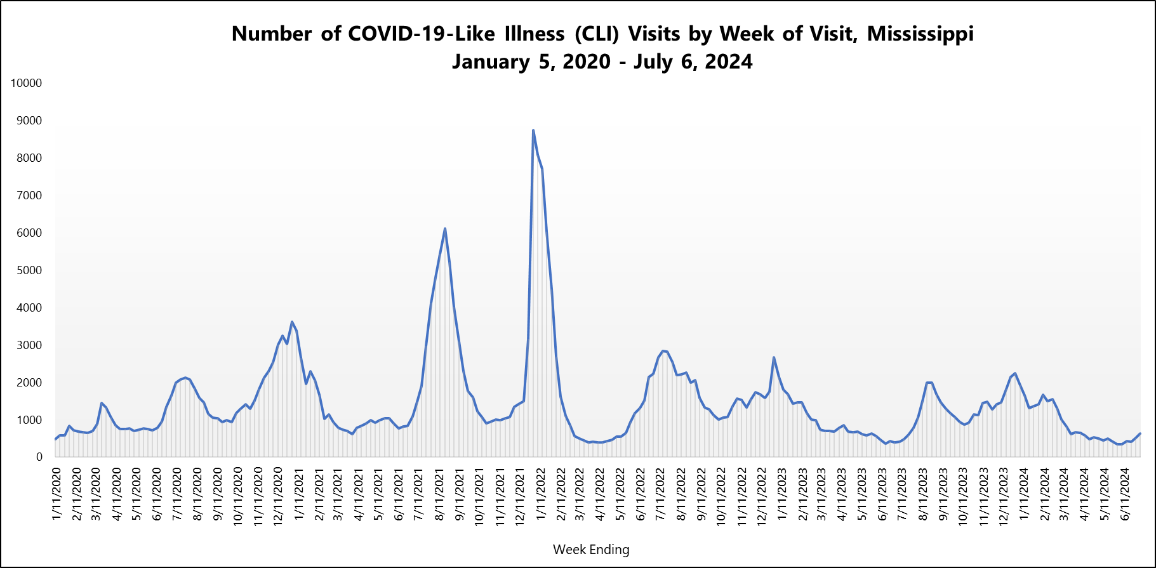

Slide 10
Key Messages

Slide 11
Vaccination! Stay Up to Date with COVID-19 Vaccines
On June 27, 2024, the CDC Director adopted the ACIP’s recommendations for use of 2024–2025 COVID-19 vaccines in people ages 6 months and older as approved or authorized by FDA. The 2024–2025 vaccines are expected to be available in fall 2024.
Learn more: www.cdc.gov/media/releases/2024/s-t0627-vaccine-recommendations.html

Slide 12
Additional Steps
Practicing good hygiene by covering coughs and sneezes, washing or sanitizing hands often, and cleaning frequently touched surfaces.
Taking steps for cleaner air, such as bringing in more fresh outside air, purifying indoor air, or gathering outdoors.
Return to normal activities when, for at least 24 hours, symptoms are improving overall, and if a fever was present, it has been gone without use of a fever-reducing medication.

Slide 14
