Slide 1
COVID-19—What’s New

Slide 2
COVID-19
Most indicators show low activity in US (namely indicators that indicate severity, such as rates of hospitalizations and deaths, which have decline)
Test positivity, which can be an early indicator for increasing activity, has slightly increased from 4.6% to 5.4%.
Wastewater viral activity (looking for the virus in wastewater) slightly increasing in a few areas in the US as well.
Emergency Department visits for COVID-19 trending up
Even though increasing in some areas, COVID-19 activity remains low
Influenza and RSV (other respiratory viruses) activity low as well.

Slide 3
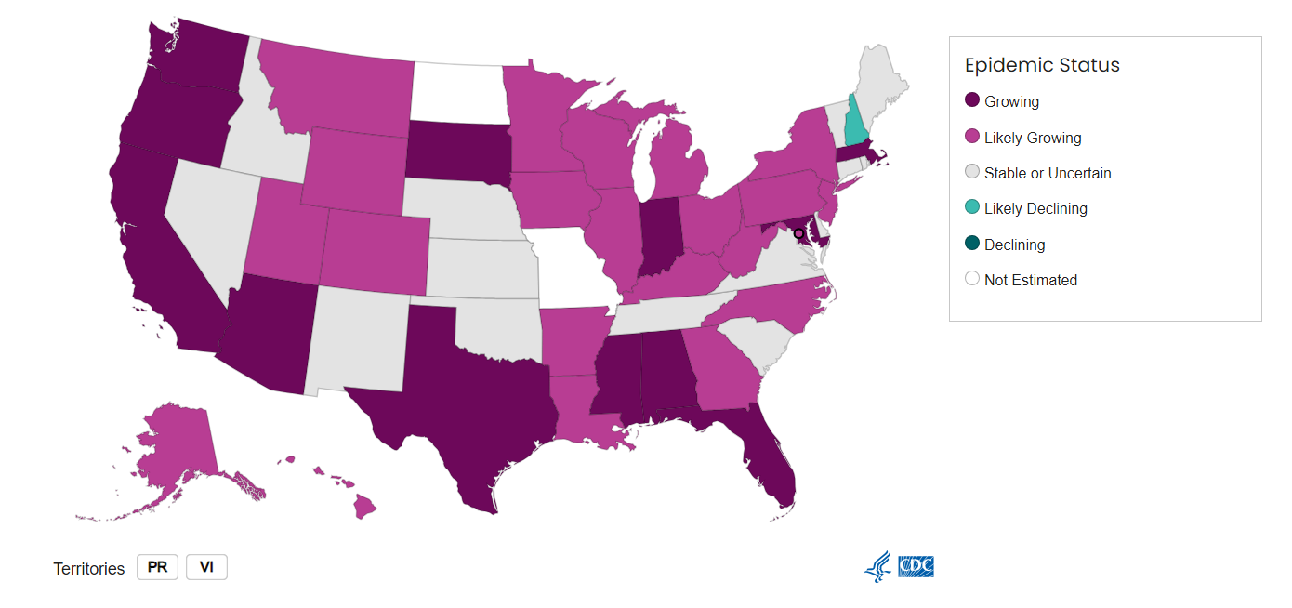
CDC modeling Epidemic Growth Status
CDC modeling does show that transmission may be growing in MS

Slide 4
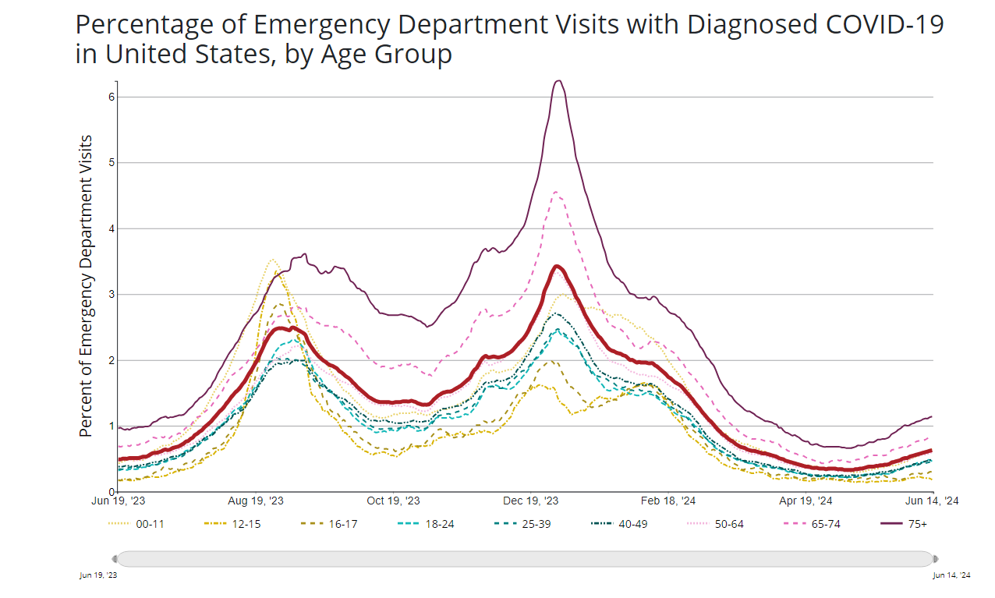

Slide 5
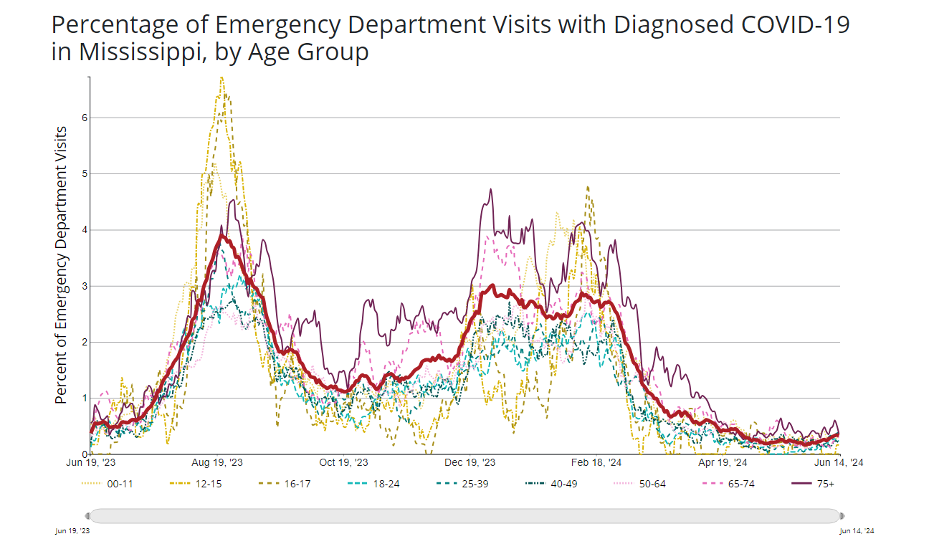

Slide 6
In the News!
FDA has instructed vaccine manufacturers to update COVID-19 vaccines to target the KP.2 strain for next Fall—
What this means—vaccines will continue to be updated, likely seasonally, to provide protection against circulating strains of virus
KP.3 variant strain makes up 25% of new COVID-19 cases (closely related KP.2 makes up about 22.5%--both are FLiRT variants)
Why that’s important—new variant strains can evade the immune response from previous versions of the virus, even if you have been previously infected or vaccinated.
Combined Influenza/COVID-19 Vaccine looks promising
Why that’s important-vaccines say lives, preventing millions of deaths each year. Combination vaccines mean fewer injections, fewer complications, etc. A two in one vaccine can increase vaccine coverage! We will see continued recommendations for yearly COVID-19 and Flu vaccines!!

Slide 7
Other Public Health
Multiple Salmonella Outbreaks CDC tracking—tend to see higher incidence of Salmonella and other enteric organisms (causing GI illness) in the late spring and summer months
Some outbreaks in 2024:
Cucumbers-196 ill in 28 states and DC, ongoing
Fresh Basil-12 ill in 7 states-still ongoing
Charcuterie Meats—104 ill in 33 states-closed
Pet Beaded Dragons—15 ill in 9 states, investigation still open
Backyard Poultry—109 ill, 29 states (including MS), active
Always wash your hands after contact with animals, after using the restroom, before and after preparing food, keep cold foods cold, and hot foods hot and cooked to correct temperature, watch for food recalls

Slide 8
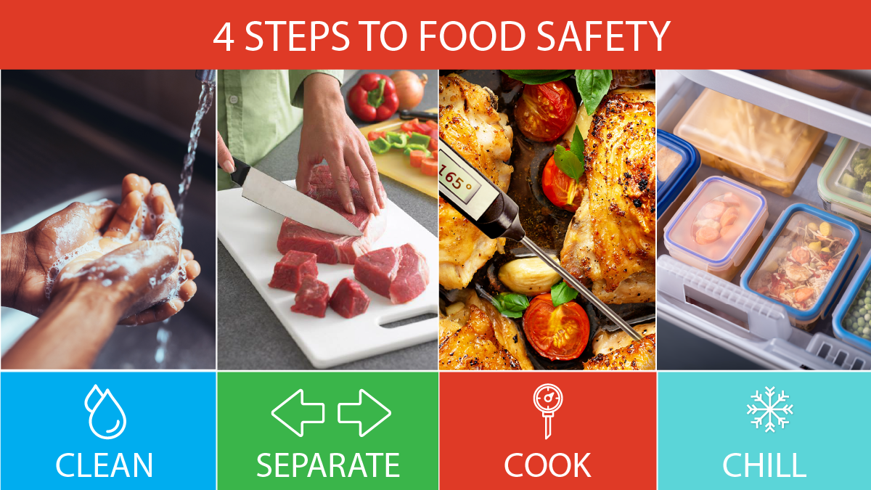
Remember to follow the 4 steps to food safety: Clean, Separate, Cook and Chill to help keep you and your family safe from Salmonella.

