Slide 1
The feet the ankle and the lower extremity To Flow or Not to Flow??
Dr. Renita T. Parker
Memorial Hospital System
MS Gulf Coast

Slide 2
Objectives:
The Important Link between Podiatry and Vascular Disease
The clinical evaluations
The Tests
The Referral
The Team Approach

Slide 3
Diabetic Stats:
Total: 38.4 million people of all ages had diabetes (11.6% of the population) in 2021.
38.1 million were adults ages 18 years or older.
Diagnosed: 29.7 million people of all ages had been diagnosed with diabetes (8.9% of the population).

Slide 4
Lower-limb amputations
surgery to remove a toe, foot, or leg, are increasing in the US, and 80% are a result of complications from diabetes. From 2009 to 2019, the number of diabetes-related hospitalizations due to amputation doubled.

Slide 5
The Conversation
Pt will often give key phrases:
my foot hurts when I walk I have pain that radiates into calf
my foot cramps or becomes numb
I wake up in the middle of the night with
pain but it feels better after I hang my foot down

Slide 6
Leg Cramps
The cramps that effected girls and boys

Slide 7
Leg Cramps: The cramps that affect boys and girls
Vascular diseases:
coronary artery disease,
peripheral vascular disease
vascular occlusive disease
Kidney diseases:
renal dialysis, hypokalemia
Neurological diseases:
neuropathies, motor neuron disease

Slide 8
Ankle Brachial Index

Slide 11
Mr. I can’t miss work
44 y/o male ptc for pain and discoloration to toes L foot x 1 month unknown reason
Clinical Appearance
hyperpigmentation to 1,5th digits of left foot with mild pain
XR, labs week 1
Week 2 hyper pigmentation improved
With local wound care
Week 3 pt states increased pain hyper pigmentation is getting worse wound sites
~CT anginography are ordered LLE is completely
Occulsion RLE and LLE found

Slide 12
Week 3
Pt notes pain to the LLE
He has continued working 16 hour days
Wounds at distal toes are noted changes
Increased drainage
Bone exposure
Increased pain in the left leg with guarding
CT Angiography

Slide 13
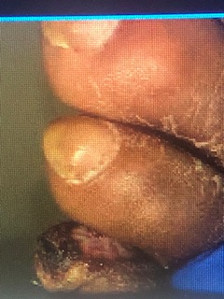
Bedside Pictures

Slide 14
CTA Report
Impression:
Marked Abnormal b/l
Floating Nonocclusive thrombosis Abdominal
Aorta
Occlusion of the R Anterior Tibial Artery down
Pt was admit to floor
Anti-Coag treatment, stent placement
Cardiac Output <20%

Slide 15
The Newbie
64 y/o black female ptc states foot has been sore for the past 4 days without any history trauma/injury pain is 10/10
No home treatments or previous clinic eval
PMH: HPT, COPD, Emphysema, Hep C, HIV
SH: IV drug use, Tobacco Abuse
Labs: wnl
XR: noted normal

Slide 21
The Brothers
Pt 65 y/o male ptc with hyperpigmentation
And pain at right foot pt states that he hit the foot on the side of the bed and is now discolored and tender.
XRs, labs ordered Arterial Doppler ordered
SH 40(+) years smoking ppd

Slide 22
65 y/o AA male
Uncontrolled DM
SH: smoking 40 (+)
Start he hit the door
XR, labs, sed rate Arterial doppler ordered
A-gram with stent placement

Slide 25
Brother 2
Pt ptc with simple heel ulceration
SH: 30(+) ½ ppd smoking history
Evaluated debrided,
Labs/Xrays/Arterial Dopplers
Marked decrease <.5
Referred to Cardio for Intervention

Slide 26
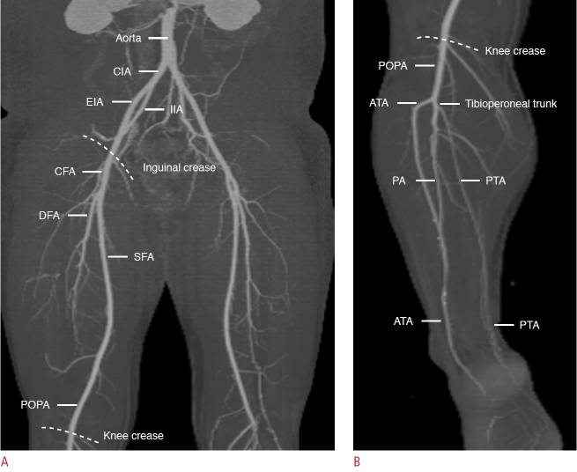
The Tricky Part

Slide 27
Aortoiliac Disease (AOD)
Pt was referred to Vascular for surgical intervention
Recovery uneventful
Wound healed

Slide 28
Leriche Syndrome (LS)
LS was first described in 1914 by Robert Grahman
commonly referred to as aortoiliac occlusive disease (AOD), is a product of atherosclerosis affecting the distal abdominal aorta, iliac arteries, and femoropopliteal vessels.

Slide 29
Symptomatic:
classically presents with a triad of claudication, impotence, and absence of femoral pulses.
Claudication refers to cramping leg pain that is reproducible by exercise.

Slide 30
AOD
Risk factors
Family Hx: DM type 2
Tobacco use CVA
Heart Attack
Dx: segmental pressures or doppler studies (LE dz)
Possible pain with walking

Slide 31
Building Effective Partnerships Between Vascular Surgeons and Podiatrists in the Effective Management of Diabetic Foot Ulcers​
Jan 15, 2015 Timothy Wu, MD and Rabih A. Chaer, MD
Leriche R, Morel A. The syndrome of thrombotic obliteration of the aortic bifurcation. Ann Surg. 1943;127(2)
Diehm C, Schuster A, Allenberg JR, Darius H, Haberl R, Lange S, Pittrow D, von Stritzky B, Tepohl G, Trampisch HJ. High prevalence of peripheral arterial disease and co-morbidity in 6880 primary care patients: cross-sectional study. Atherosclerosis. 2004;172(1):95–105.
Krankenberg H, Schlüter M, Schwencke C, Walter D, Pascotto A, Sandstede J, Tübler T. Endovascular reconstruction of the aortic bifurcation in patients with Leriche syndrome. Clin Res Cardiol. 2009;98(10):657–64.

Slide 32
Extras
Can we talk…….

Slide 33
Open Wounds

Slide 34
CW
Pt had been seen in wound care for chronic ulceration
Due to noted findings on MRI
d/w pt OM treatment options
Oral, IV, surgery
1st ray resection performed
Buttttttt>>>>>>>>>

Slide 35
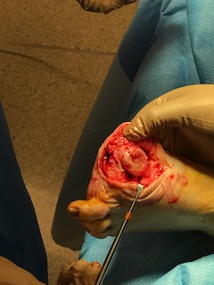

Slide 36
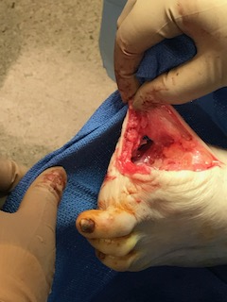

Slide 39
CW 3 months post op

Slide 40
The Covid Patient The aftermath
Pt ptc 42 y/o female:
h/o Heart Attack in classroom
Hospitalized Dx’d with Covid
Ptc with b/l ankle ulceration 4x4 left 2x2 right
Wound care started due to Cardiac h/o
Advised pt to f/u with Cardiology
Pt underwent CXR abnormal mass found
Sent to Pulmonolgy

Slide 41
Lesion was noted benign
Last day:
BP note low bp 60/50 in office
Weak, had not eaten 3 days
Recommended ER evaluation
Pt admit to the floor on Tuesday
Placed on vent on Sunday
Following Tuesday expired 2:45 pm
Cause multi system failure
Drinking a bottle of whiskey night

Slide 42
Ted from Kentucky
Pt notes Covid x 2 months ago
Hospitalization x3 weeks ago: labs indicated dehydration
Pt notes h/o hallucination over the past 3 weeks with vivid conversation with a friend named Ted
Pt states hallucinations are becoming scary at times in which he felt like driving like he was in NASCAR to visit
Discussed case with PCP/ER
Pt left visit against medical advice

