Slide 1
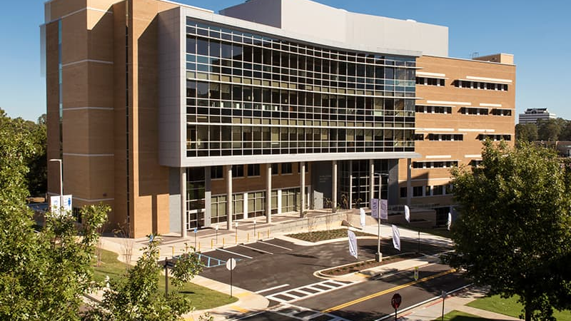
Mississippi Health Ambassadors
Thomas Dobbs, MD, MPH
October 20, 2022

Slide 2
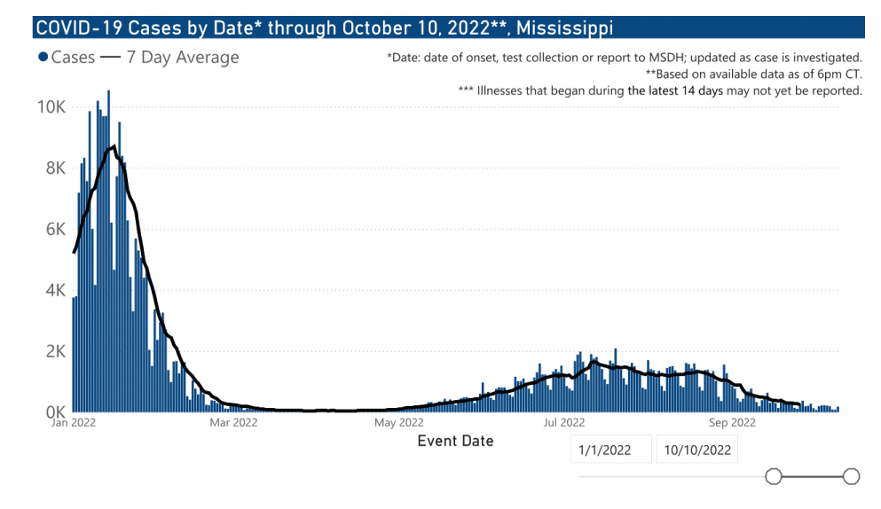
COVID Update

Slide 7
COVID-19 Vaccines
What: New Bivalent COVID Vaccine Booster (includes Omicron coverage)
Who: Especially those who are older or with serious medical issues. Kids 5 and older can get the Pfizer version.
When: 4-6 months after last COVID vaccine or infection
Where: Pharmacies, Clinics, Health Depts (vaccines.gov)
Can I take the flu shot at the same time? Yes

Slide 8
Key Messages:
COVID is still here and especially worrisome for older Mississippians
New COVID-19 Booster doses are here – that cover Omicron variants
If you get COVID and are high risk – talk with your doctor about treatment
Influenza is on the way!

Slide 9
Influenza

Slide 10
Time to get your flu shot

Slide 12
Breast Cancer
About 1 in 8 U.S. women (about 13%) will develop invasive breast cancer over the course of her lifetime.
In 2022, an estimated 287,850 new cases of invasive breast cancer are expected to be diagnosed in women in the U.S., along with 51,400 new cases of non-invasive (in situ) breast cancer.
About 2,710 new cases of invasive breast cancer are expected to be diagnosed in men in 2022. A man’s lifetime risk of breast cancer is about 1 in 833.
Breast cancer is the most commonly diagnosed cancer among American women. In 2022, it's estimated that about 30% of newly diagnosed cancers in women will be breast cancers. *This information is provided by Breastcancer.org. Donate to support free resources and programming for people affected by breast cancer.

Slide 15
Breast Cancer
In the U.S. – mortality rate
Among African Americans
40% higher

Slide 17
What is driving this disparity?
Lack of Health Insurance (Breast Cancer Screening)
39% uninsured
75% insured
Access and utilization of medical services and advances
Higher rate of “triple negative” breast cancer in African Americans
*mammogram within 2 years, 2018 data

Slide 18
Barriers to Screening
Low income or worry about cost
Lack of access to care (such as lack of transportation to a mammography center)
Lack of a usual health care provider
Lack of a recommendation from a health care provider to get mammography screening
Lower education level
Lack of knowledge of breast cancer risks and screening methods
Lack of child or elder care
Lack of sick leave or unable to miss work
Fear of bad news or pain from the mammogram
More recent migration to the U.S. (born outside the U.S. and living in the U.S. for less than 10 years)
Cultural and language differences

Slide 19
Fighting Disparities / Saving Lives

Slide 20
MS Breast and Cervical Cancer Program

Slide 21
Key Messages
Breast Cancer can be >90% curable when detected early
Women should receive screening mammography at 45-50 years of age
Family history may indicate need to start earlier
Cost is not a barrier – remember the BCCP program

Slide 22
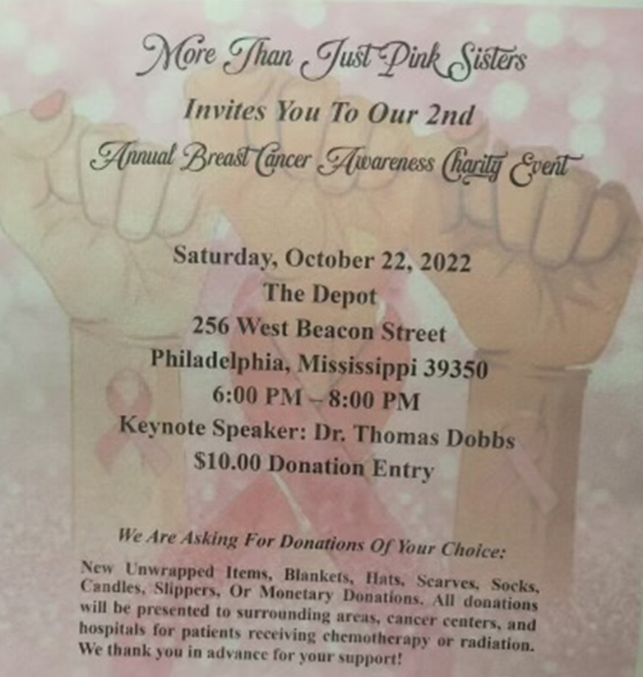
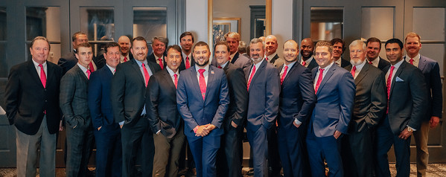
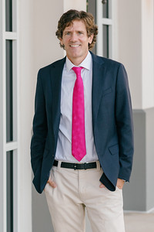
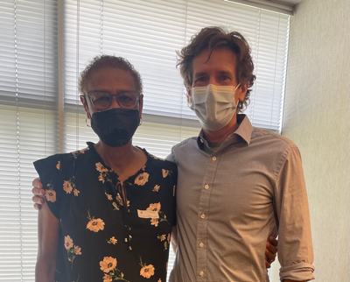
Real Men Wear Pink 2022
Raising $ for research, prevention and helping patients with breast cancer
Please give a little ($5-10) to raise awareness
Please search Real Men Wear Pink Central MS
http://main.acsevents.org/goto/ThomasDobbs

